Slide 1
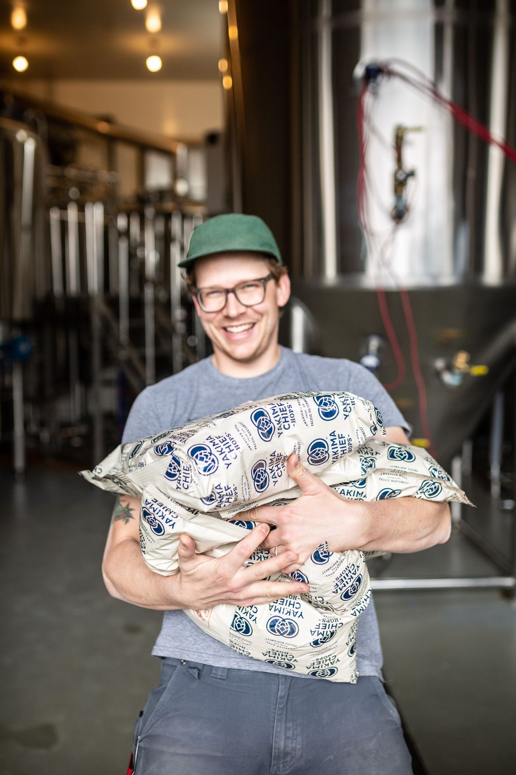

CRITICAL FACTORS IN
IPA RECIPE DESIGN
(APART FROM HOPS)
CEBC 2021
BLAKE ENEMARK
HEAD BREWER, TAILGUNNER BREWING CO.
CALGARY, ALBERTA, CANADA

Slide 2
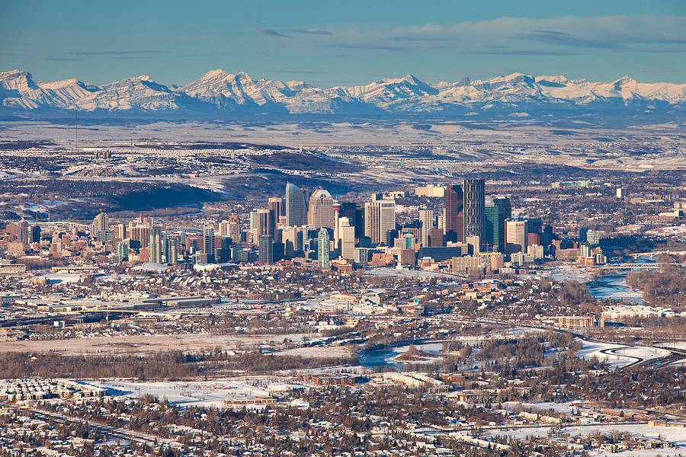




ABOUT ME
From Calgary, Alberta, Canada
Head Brewer at Tailgunner Brewing Co.
Strong focus on European-inspired lagers and
Hazy hoppy beers brewed with regional grains
My lineage: Toronto to Calgary (100 hL to 10 hL)
Great Lakes Brewing (Toronto), Last Best Brewing (Calgary), Godspeed Brewery (Toronto), O.T. Brewing (Calgary)
Focus on brewing philosophies I have learned from the mentors I have had

Slide 3
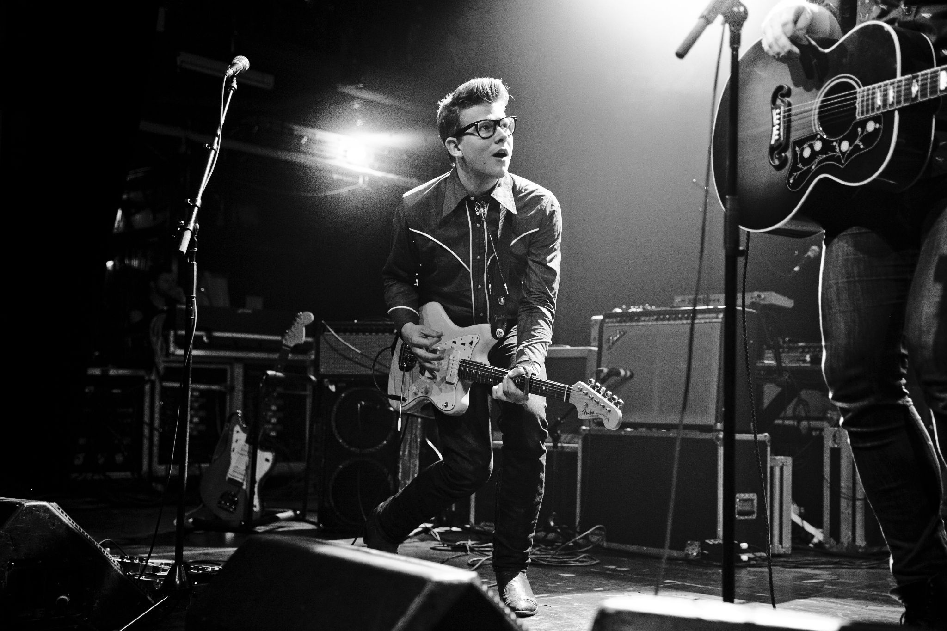
ABOUT ME

Slide 4
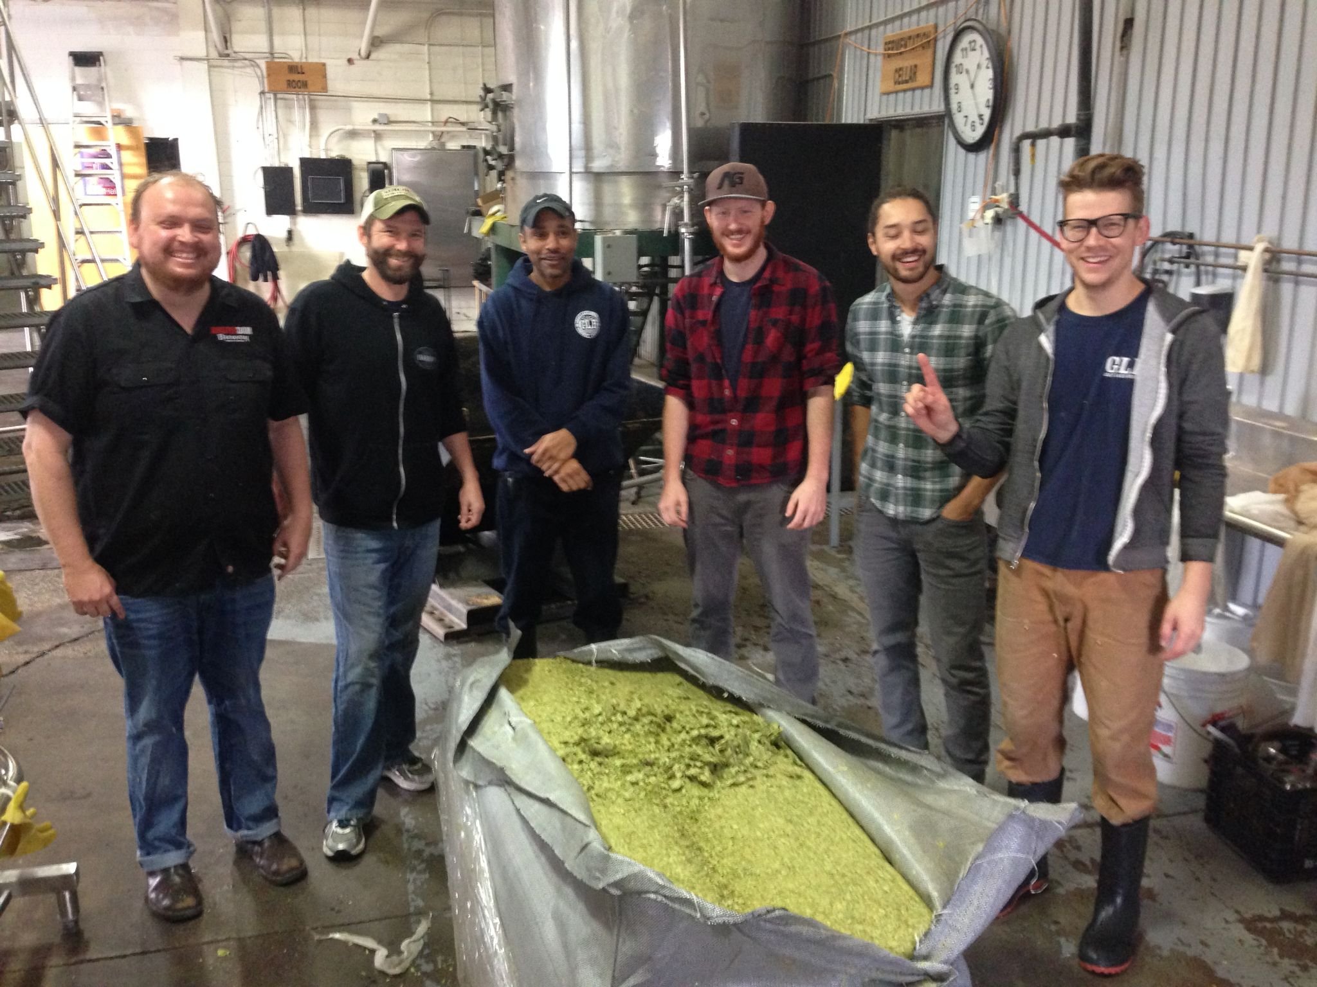

Slide 5
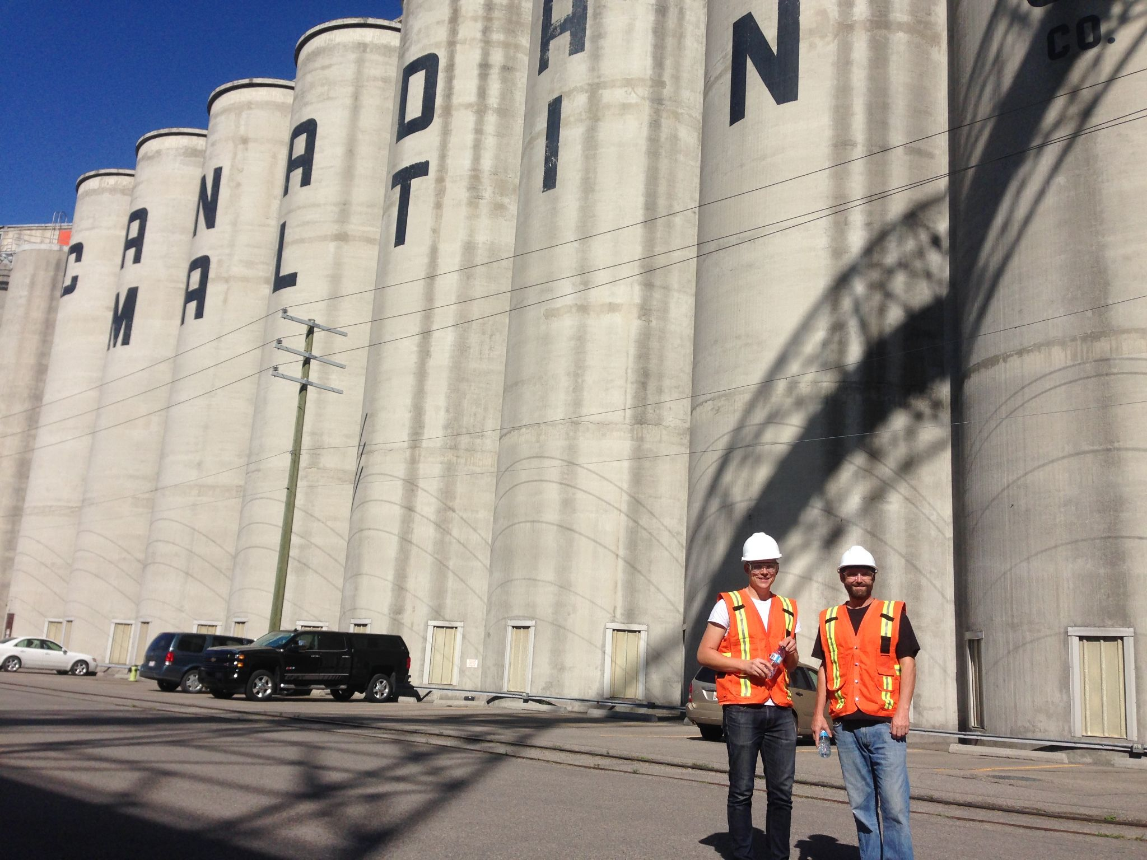

Slide 6
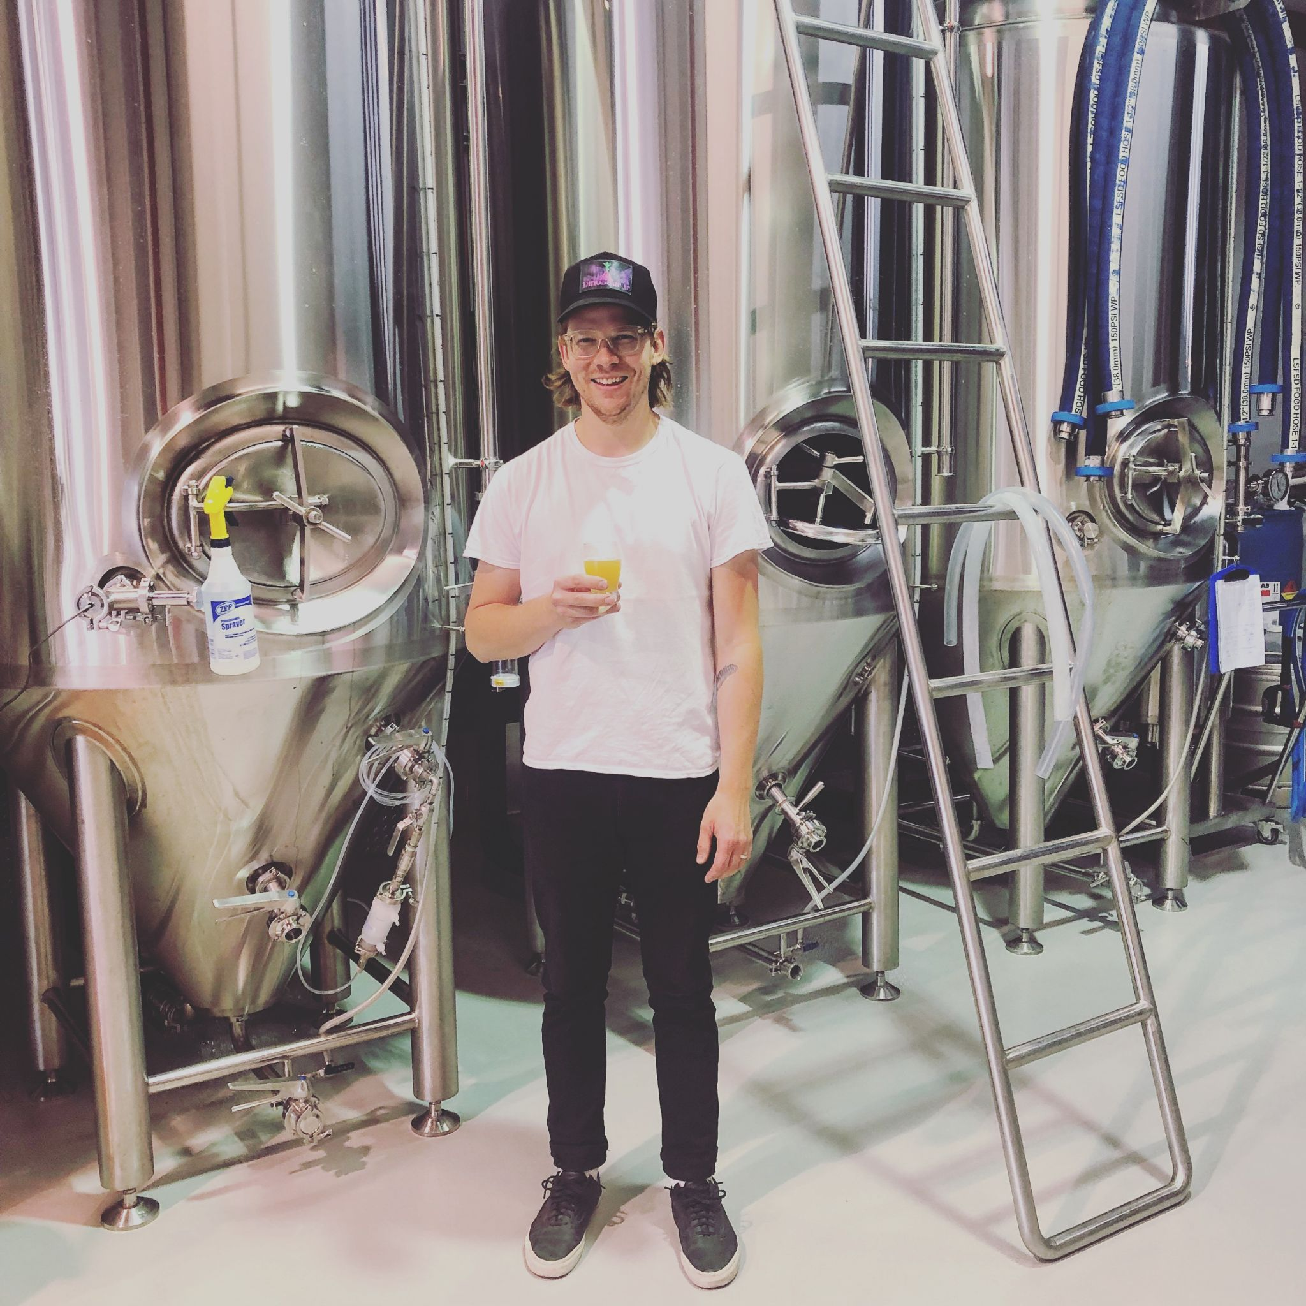

Slide 7
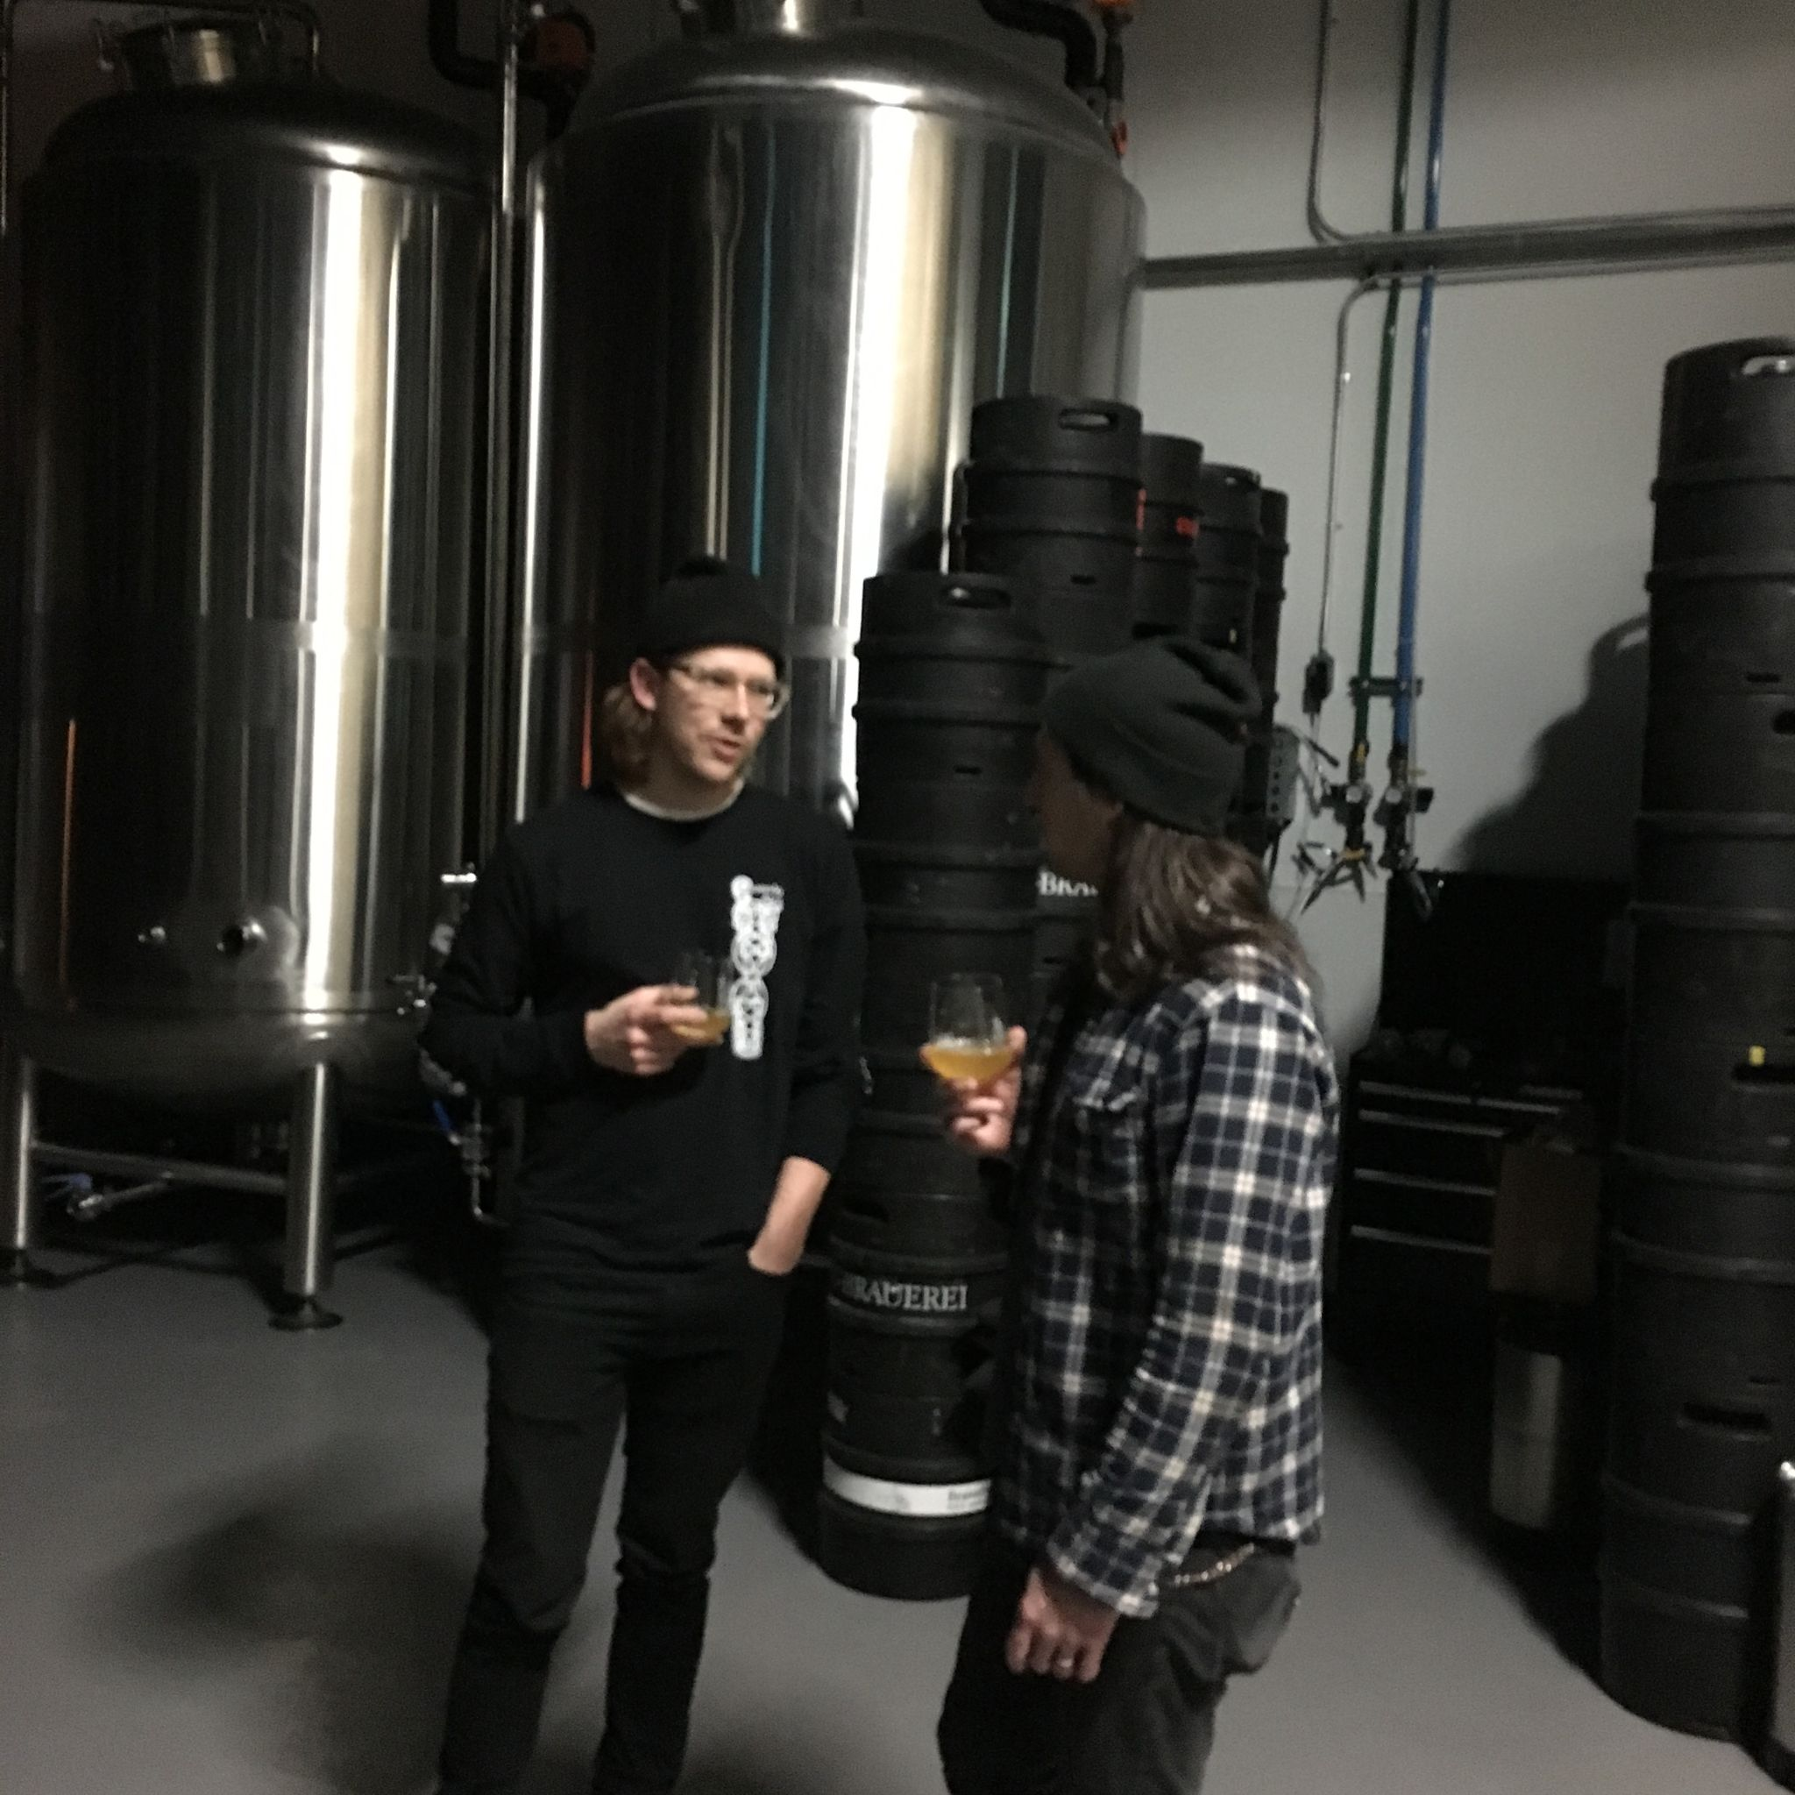

Slide 8
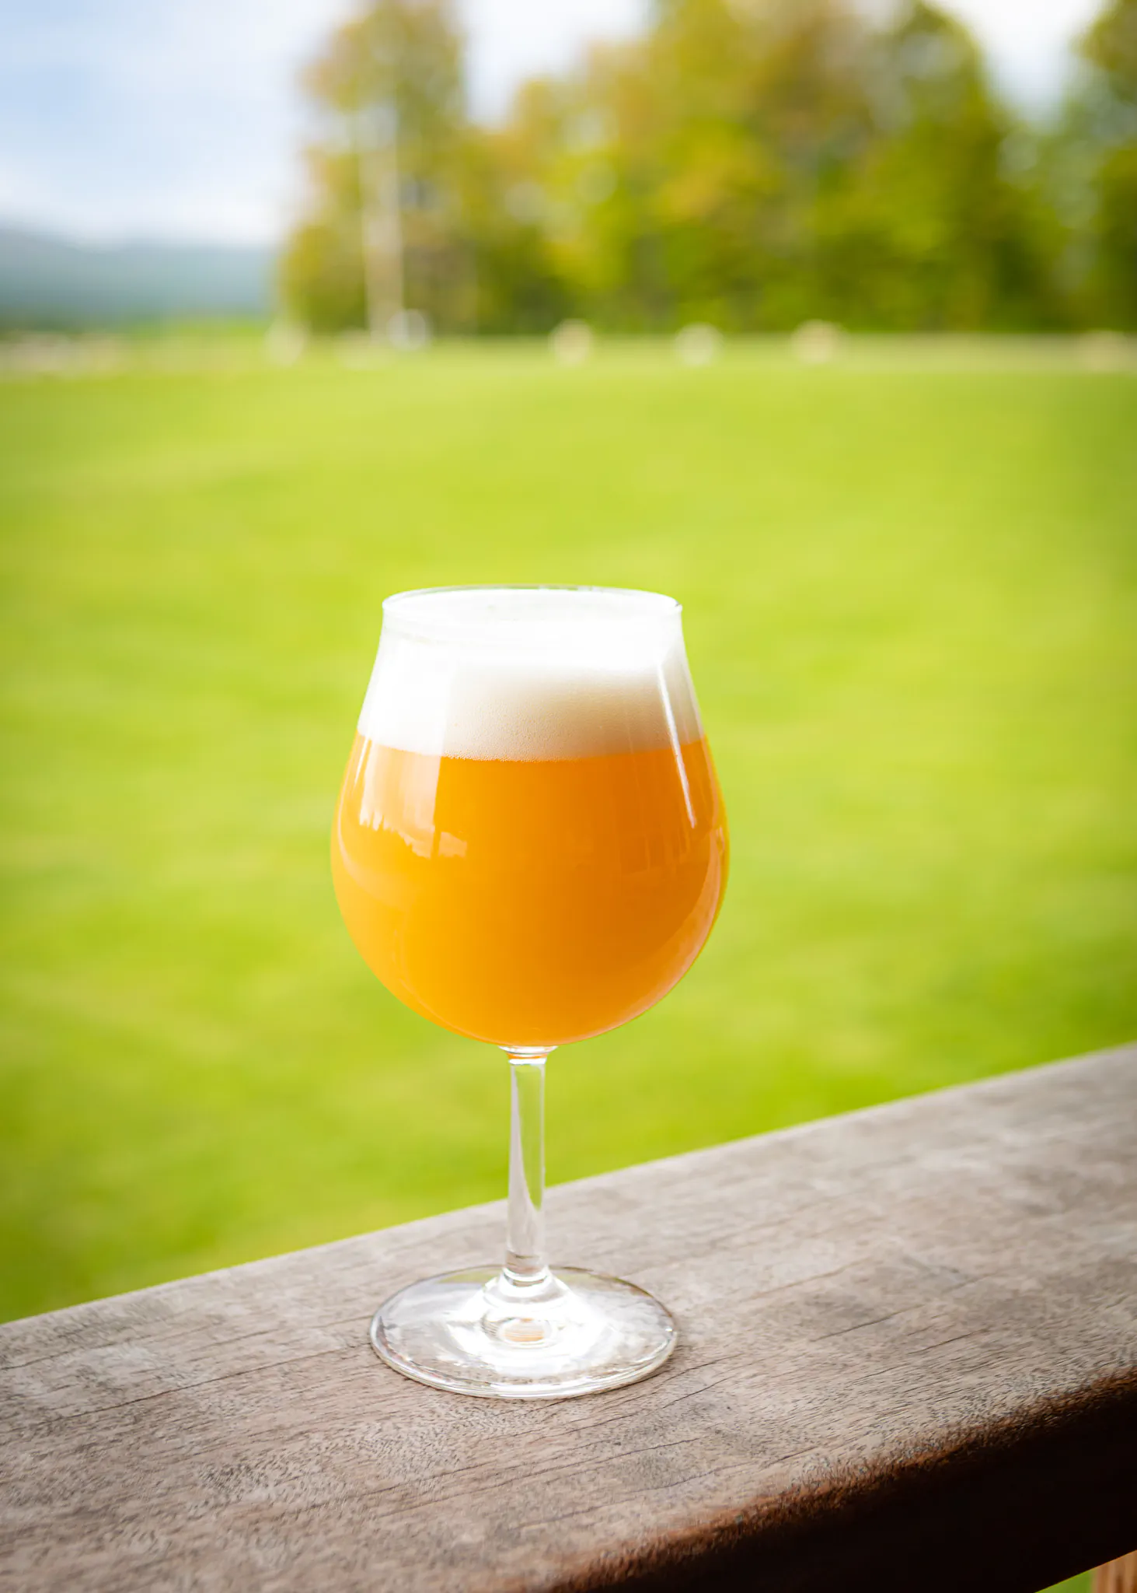
HIGH-LEVEL OVERVIEW
What is the goal, vision, and purpose for your beer?
There are many factors that go into designing, brewing, and packaging great IPAs besides hop variety selection
We will cover raw materials (water, grist, hops, and yeast)
As well as techniques (brewhouse command, cellaring, dry hopping, DO pickup, and pH)
n just hop selection.

Slide 9
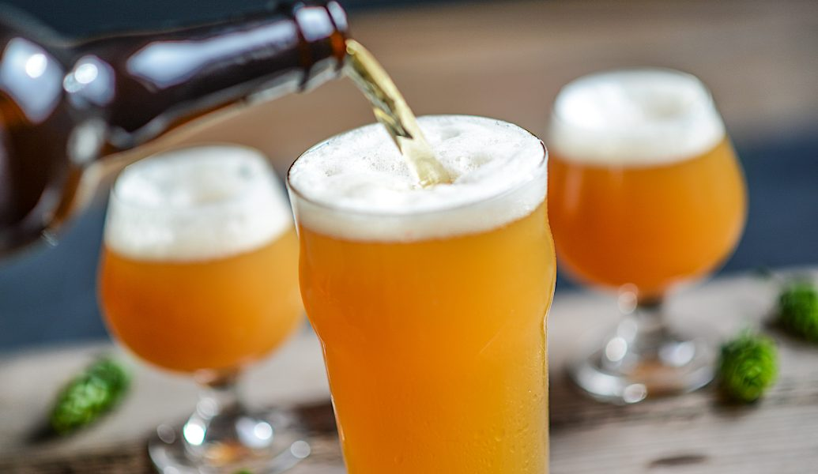
“NEW ENGLAND IPA”

Slide 10
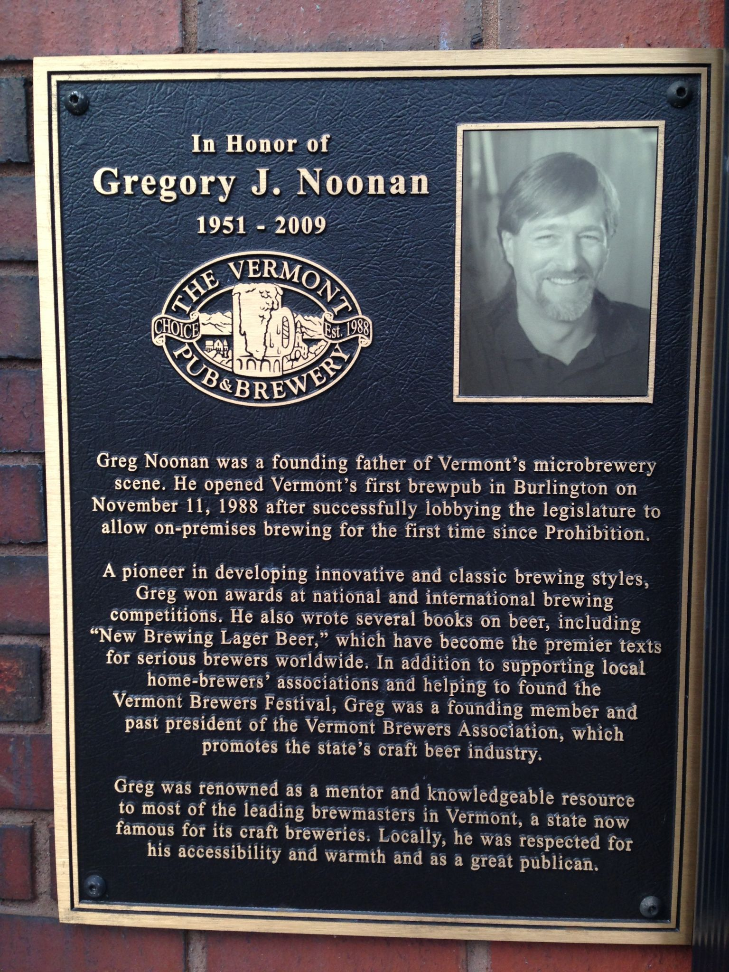

Slide 11
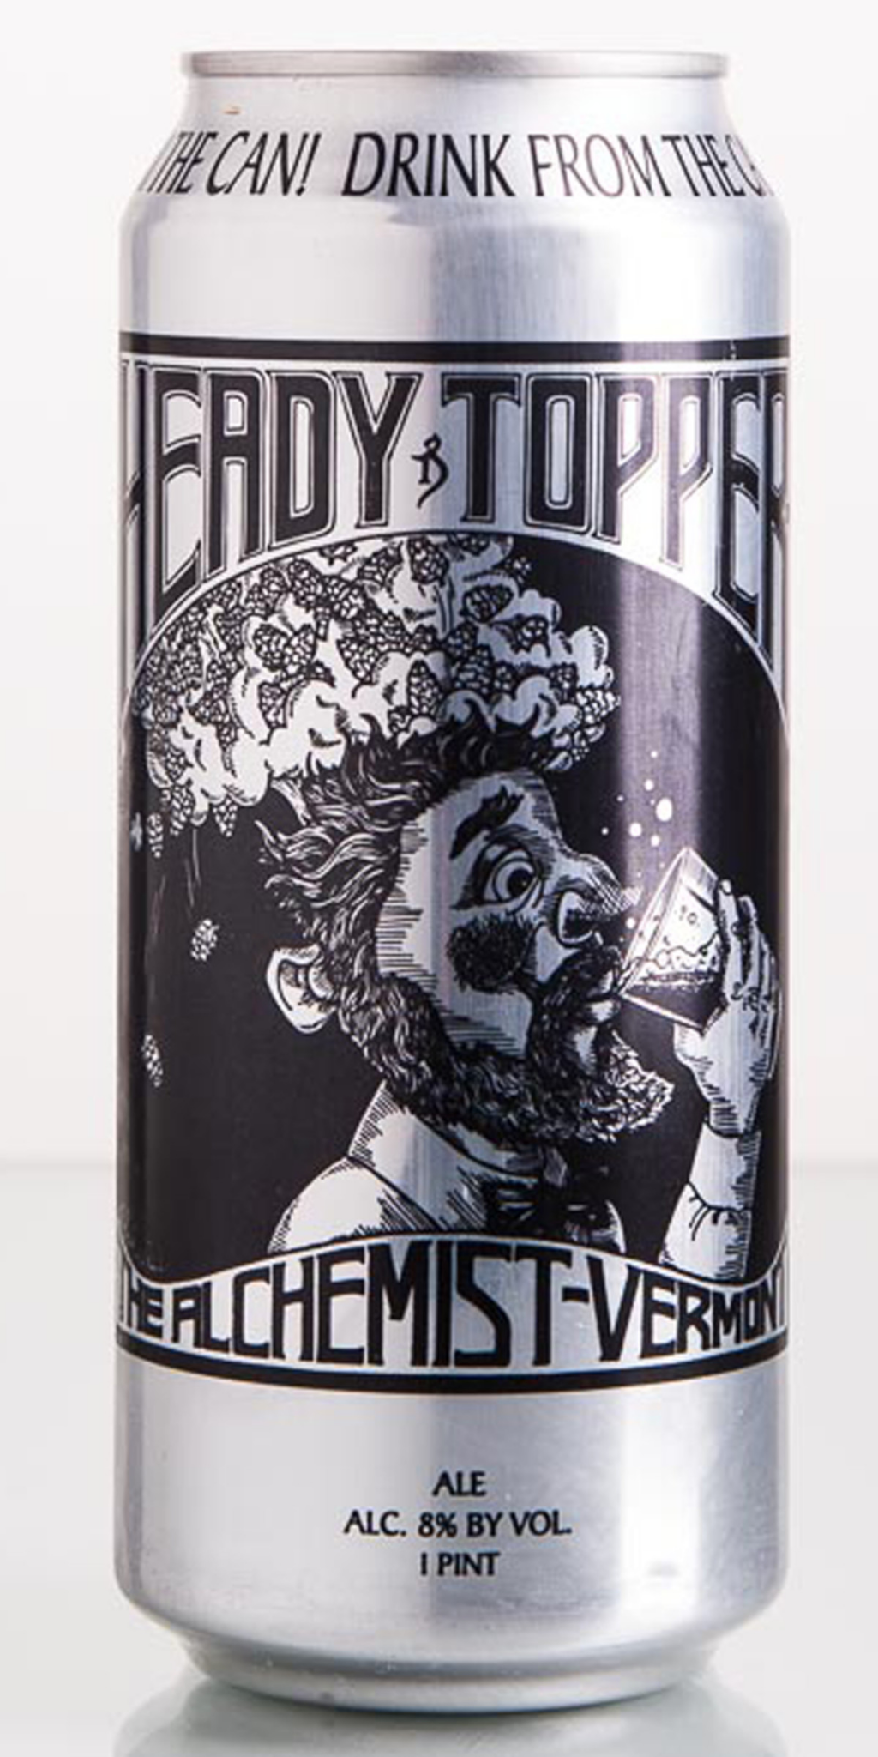
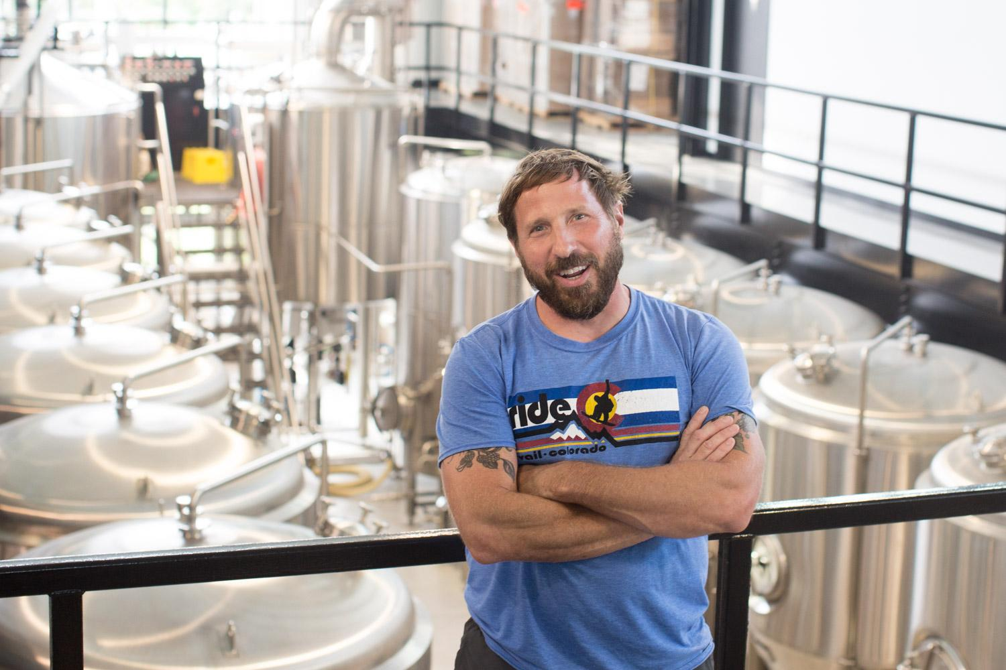

Slide 12
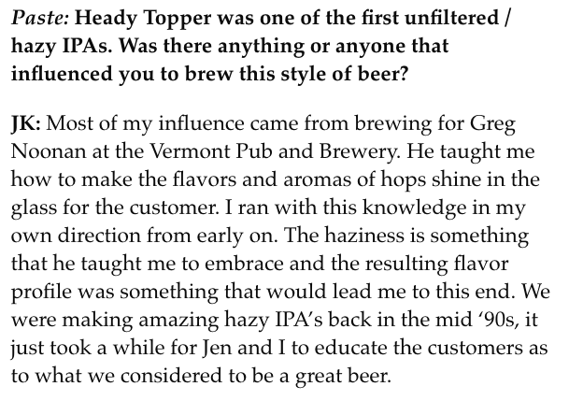
“HAZE IS A BYPRODUCT, NOT THE GOAL”

Slide 13
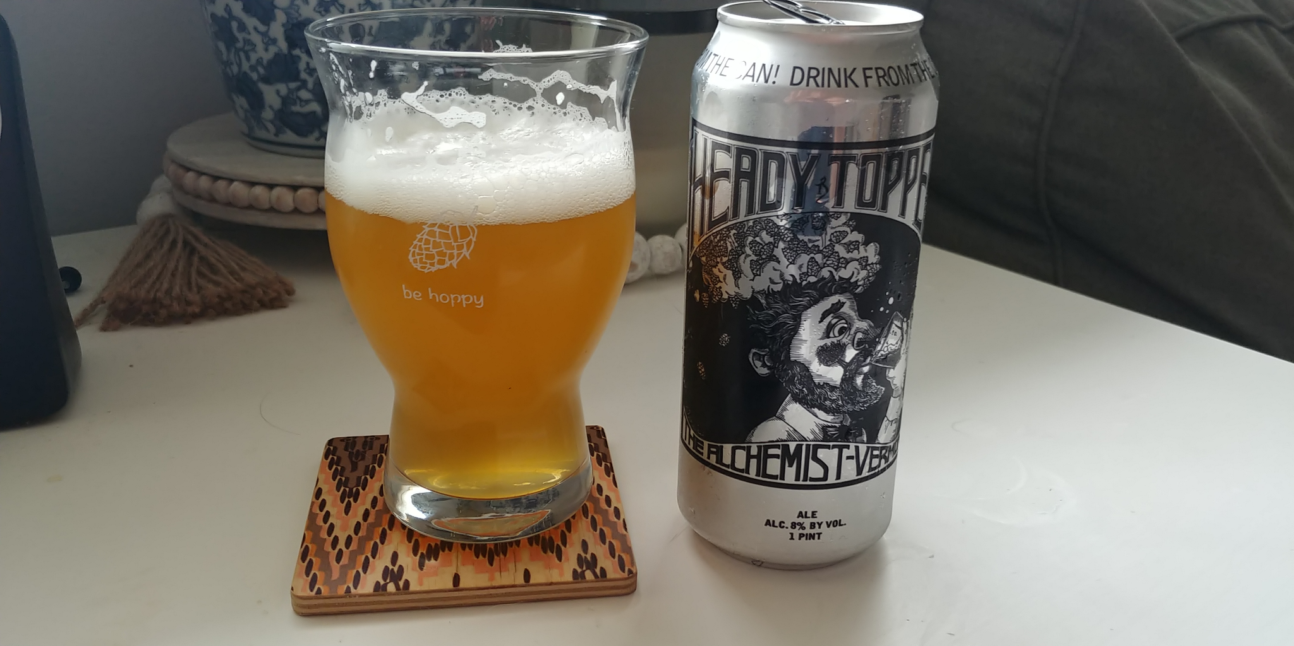

Slide 14
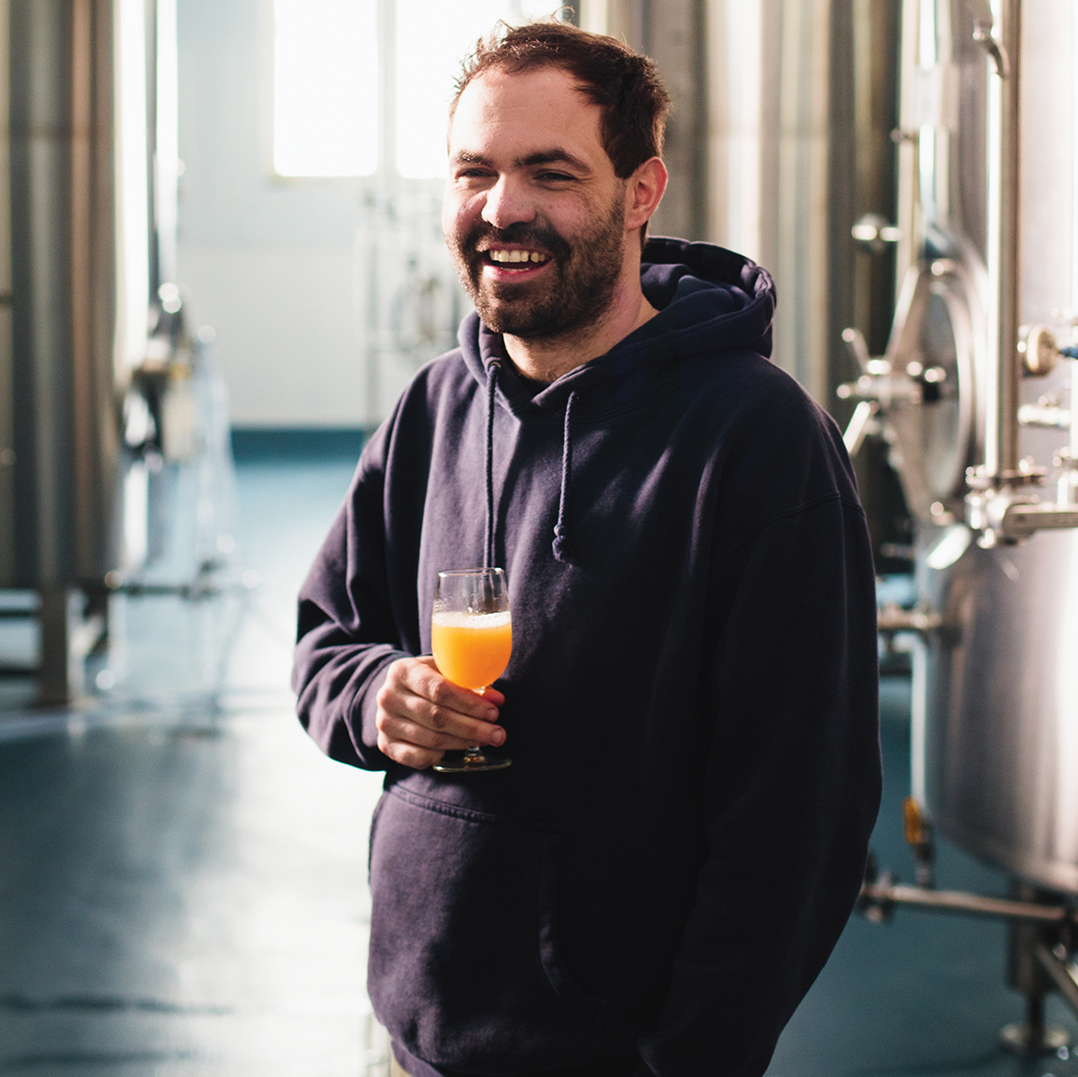

Slide 15
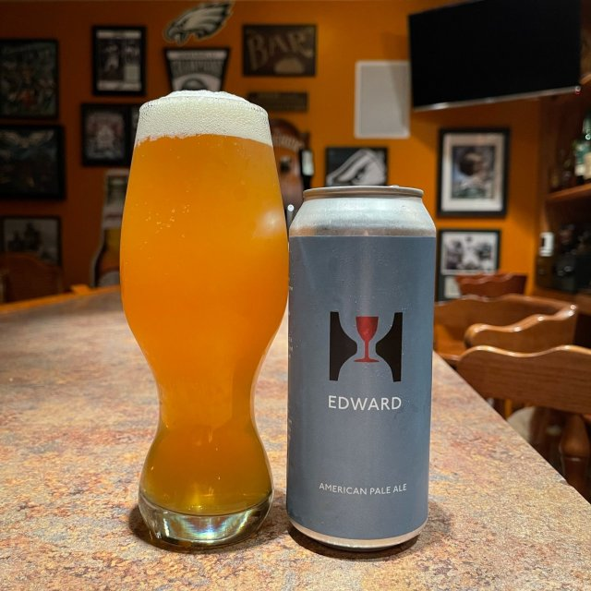

Slide 16
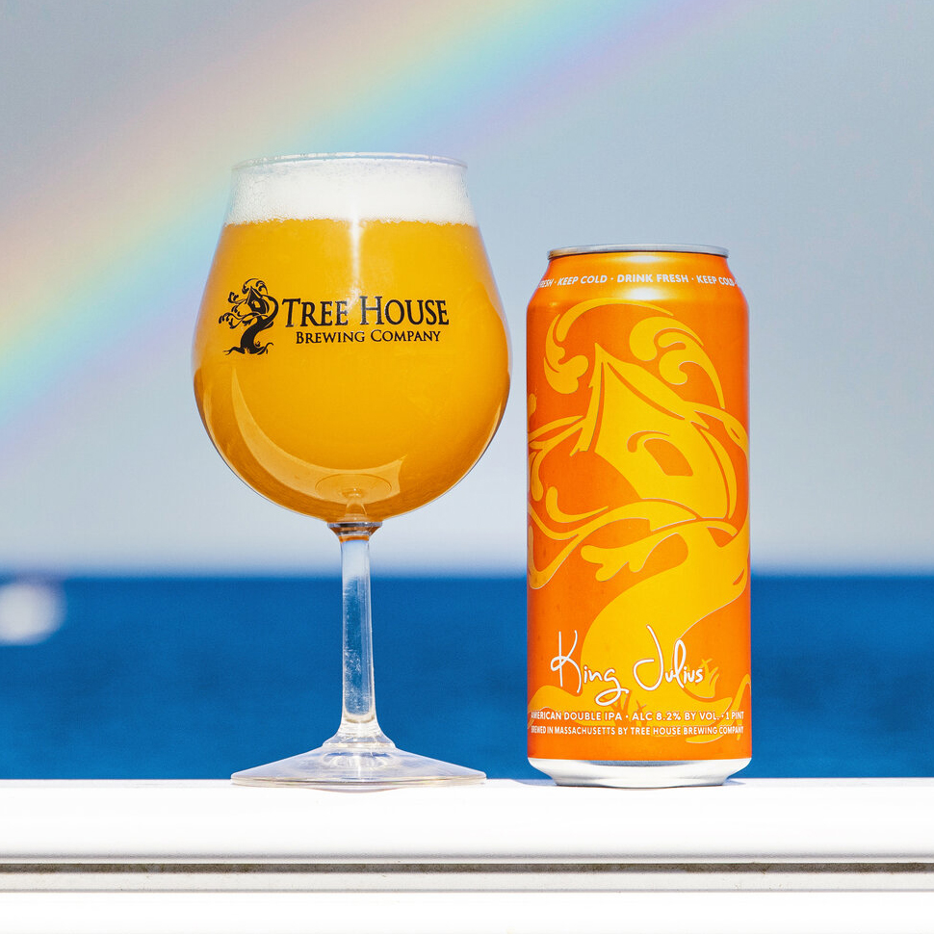

Slide 17
“WATER: THE BREWER’S SPICE RACK” - LUC LAFONTAINE
Beer is 90+% water-- arguably the most important ingredient
First, obtain a water report from a clean, recently descaled, and heated/cooled HLT sample.
What is a “desirable” water profile for brewing NEIPA?
  Balancing sulfate (snappy) and chlorides (pillowy) (2:1, 3:1)
  Magnesium = yeast health? Keep as low as possible, already in wort
  SALT. Think about cooking. Makes flavours pop. My secret weapon.
  RO users… zinc?
Bru’n Water

Slide 18
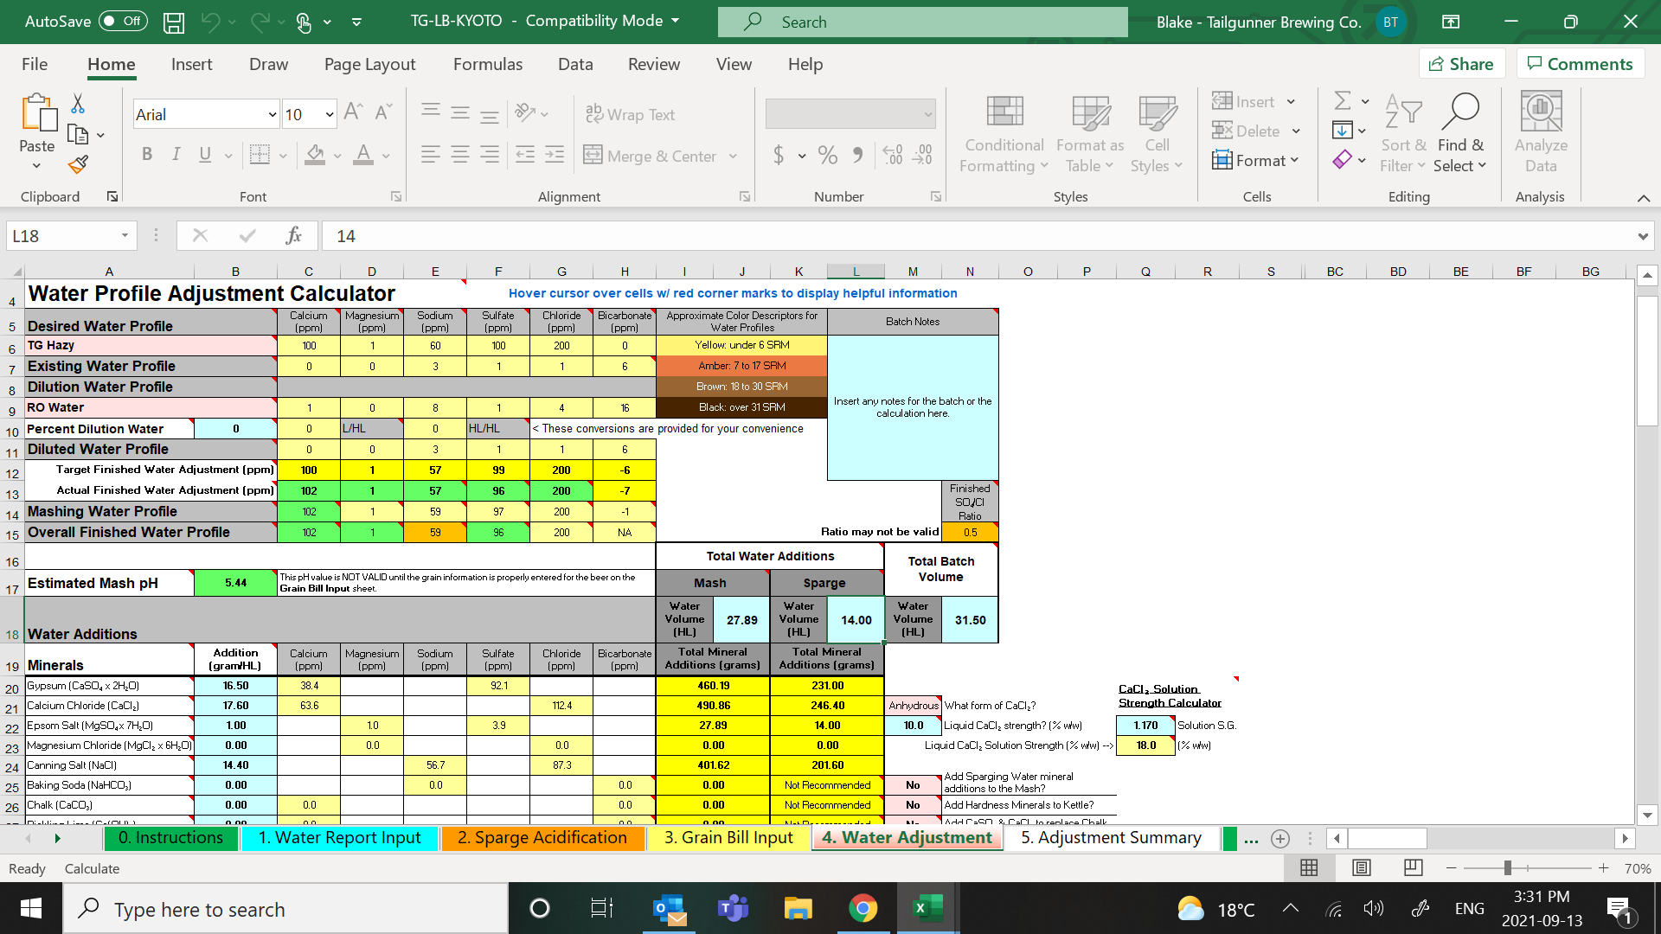

Slide 19
MY PREFERRED PROFILE FOR NEIPA
Consider your sulfate:chloride ratio; what is your goal?
Balance calcium sulfate (CaSO4) and calcium chloride (CaCl) to your target ratio
100 ppm total calcium
50-60 ppm sodium-- remember that salt helps the hops “pop”
Balance the profile using epsom salt (MgSO4) and sodium chloride (NaCl), keeping in mind that these are calcium-free paths to your sulfate:chloride ratio
Stick to your vision: brisk, snappy, and crisp? Silky, pillowy, creamy? Somewhere in-between?
Slurry your salts

Slide 20
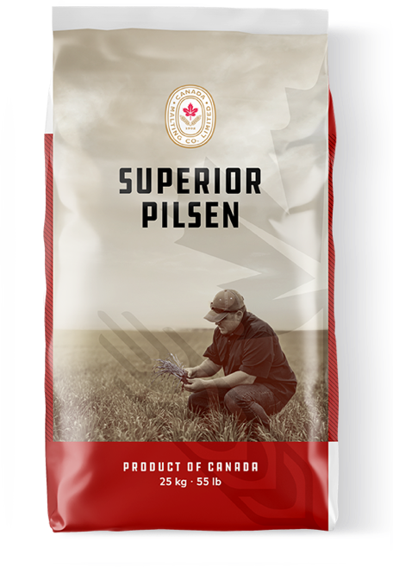
GRIST & THE MASH
Two avenues to consider: composition and schedule
Composition
NEIPA: light, agile, low SRM, silky mouthfeel
50-60% pilsner malt, 20-25% flaked oats, 10-15% malted wheat, plus room for a splash of Dextrapils/Carafoam and/or light crystal malts
Pilsner as base malt-- how neutral do you want the malt profile to be?
Could also consider English malts as a base-- the Alchemist’s Heady Topper is primarily Thomas Fawcett Pearl malt
“Don’t f*** with the hops” - Mike Lackey (Great Lakes Brewery)
n just hop selection.

Slide 21
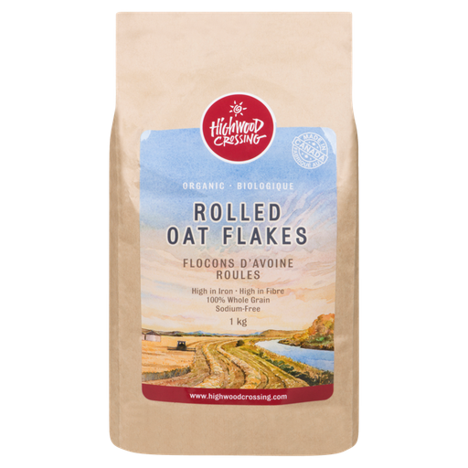
GRIST & THE MASH (continued)
Oats: add directly to the mash/lauter tun. No need to mill
Try to find a local supplier that offers baking-grade rolled oat flakes
Organic is a plus-- more flavour
Try eating your oats (and all malts!)
In Canada, brewing-grade rolled oat flakes have ZERO flavour
Wheat malt: a factor in haze stability and creamy mouthfeel-- may need to adjust your mill
Dextrapils/Carafoam: head retention/foam stability, a good option for those brewing single infusion
Crystal malts? Just a splash-- I like Soufflet 9-11 for a bit of complexity...
n just hop selection.

Slide 22
GRIST & THE MASH (continued) - SCHEDULE
How fermentable do you want your wort?
I have found 65 C is a good starting point for a final gravity of 3 - 4 plato
Personally I like NEPA finishing around 3 P and NEIPA 3.5 - 4 P
Conversion rest: 45-60 mins or until you have conversion
Verify with iodine test
Narziss rest: ramp to 71-72 C for 15-30 mins for head retention and foam stability
Mash out/sparge @ 77 C (any higher extracts tannins)
Rice hulls??? A good choice for oat/wheat heavy grain bills
A high water:grist ratio (3.5:1 and above) will also help avoid a stuck mash
n just hop selection.

Slide 23
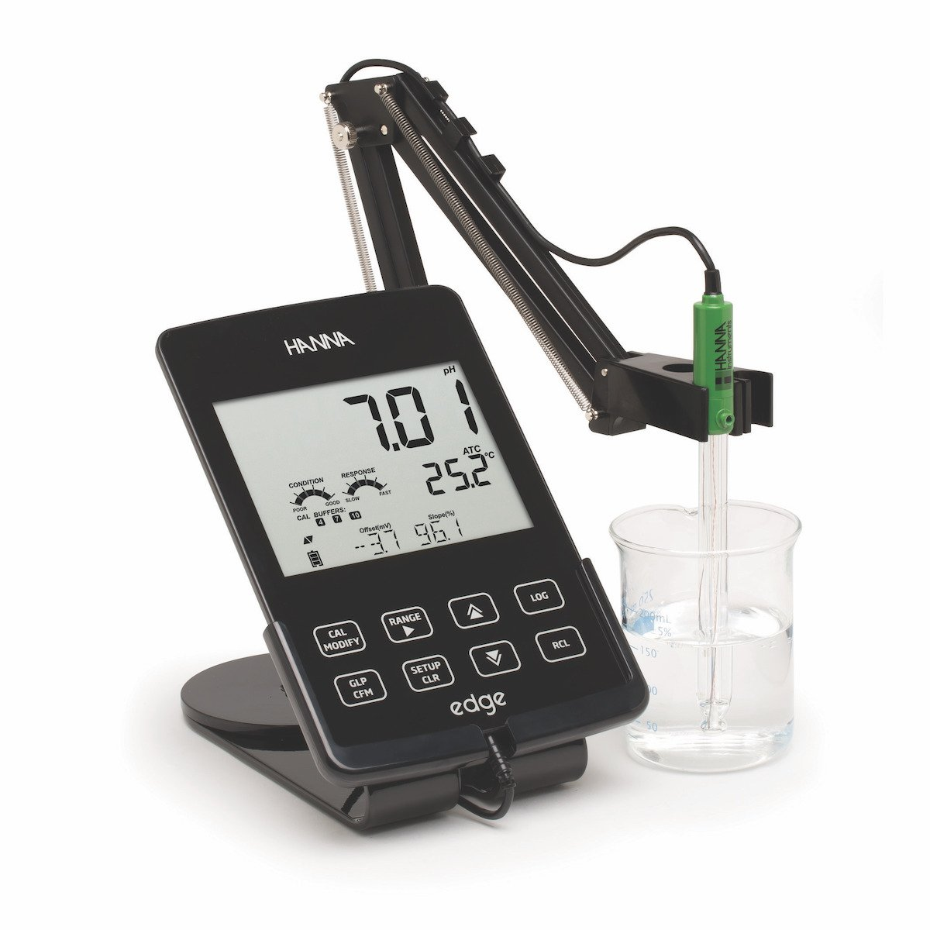
pH

Slide 24

pH
Possibly the most critical factor in brewing a successful hoppy beer
“The mash pH drives the kettle pH, and the kettle pH is a primary factor in determining the way the flavours of the beer are expressed on the palate.”
n just hop selection.

Slide 25
pH
Invest in the best possible meter your brewery can afford
Calibrate at least weekly (4, 7, 10)
I like the Hanna Edge
Closely monitor source/HLT water, mash, sparge, kettle, fermentation, dry hop, and BBT pH
pH can and should be adjusted every step of the way
The goal is to have your beer finish at or below a pH of 4.40
Find the threshold that works for you: all you need is a pint of your beer, a pH meter, a pipette, and food grade acid (lactic)
Drop and measure until the hops “pop”
n just hop selection.

Slide 26
pH
Start by knowing your HLT pH and gradually adjust the mash while mashing in
Lactic acid: organic, antimicrobial properties, flavour
I shoot for 5.10 - 5.20 (room temp) following John Kimmich (the Alchemist)
Sparge below 4.40 to break the chain of residual alkalinity-- otherwise you will see a dramatic pH spike towards the end of fermentation
Kettle pH can be adjusted during the boil, I like it between 4.90 - 5.00
Some people will drop it as low at 4.10 (the “isoelectric point”) for haze stability-- haven’t tried (yeast health)
Fermentation: DROP TRUB EVERY DAY to lock in low pH
Drop hop under pressure (will explain further in a moment), acid can be added here too
Last resort = inline during transfer to BBT. pH above 4.50 is not food safe
n just hop selection.

Slide 27
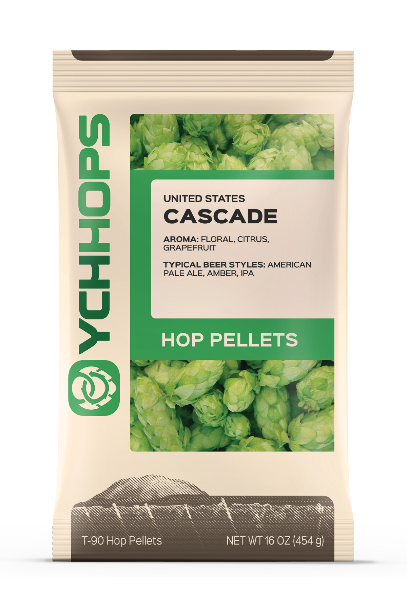
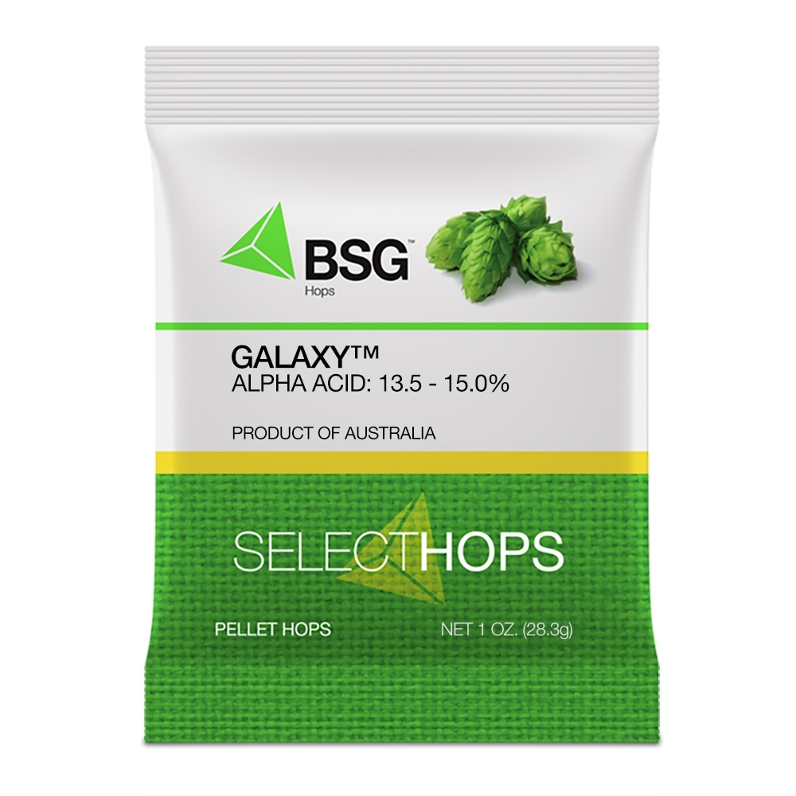
HOPS
I guess we do have to touch on hops for a little while… :)
Bass & Treble
Classic varieties = bass
New varieties = treble
Pair new varieties (AUS/NZ/USA) with classic ones (USA/UK/CZR/???)
n just hop selection.

Slide 28
HOPS - BREWHOUSE SCHEDULE
FWH for gentle bitterness. Extract is a good option-- I like Columbus
My go to hopping schedule: 5’, WP 10’, WP 0’. The Great Lakes method
Assuming you are whirlpooling for 10’, the drops get progressively bigger
Find a g/L that works for you
Some breweries hop more heavily in the KWP than in dry hopping & vice versa
Can also cool the WP slightly through the HXC (72 - 80 C)
I’ve had mixed results
n just hop selection.

Slide 29
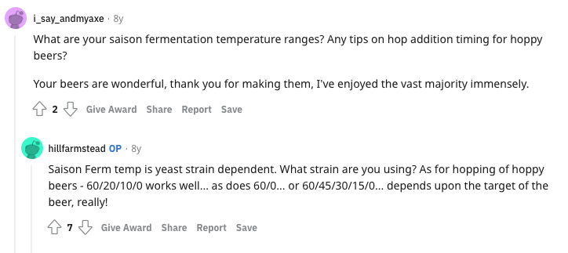
HOPS - BREWHOUSE SCHEDULE

Slide 30
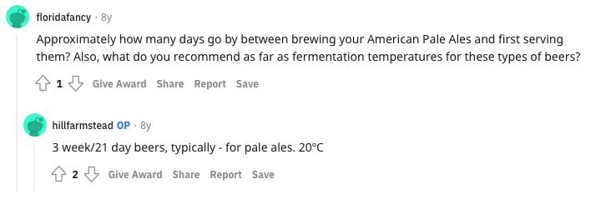
YEAST
Dry? Liquid?
English strains seem to be a good choice, although I have had excellent NEIPAs brewed with Chico… as the brewer it is up to you
n just hop selection.

Slide 31
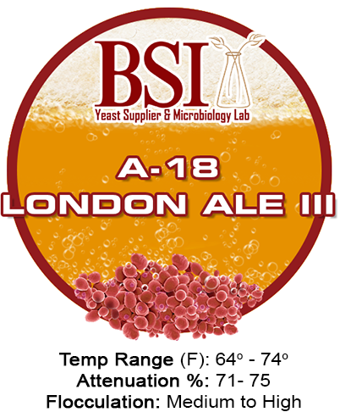
YEAST
Ferment @ 20 C, free rise to 22 C halfway to terminal gravity (7 - 8 P)
After passing a force diacetyl test, drop to 18 C w/ 1 - 2 psi positive pressure
Crop/drop as much yeast as possible before dry hopping
Introduce hops, turn cooling off, let free rise
n just hop selection.

Slide 32
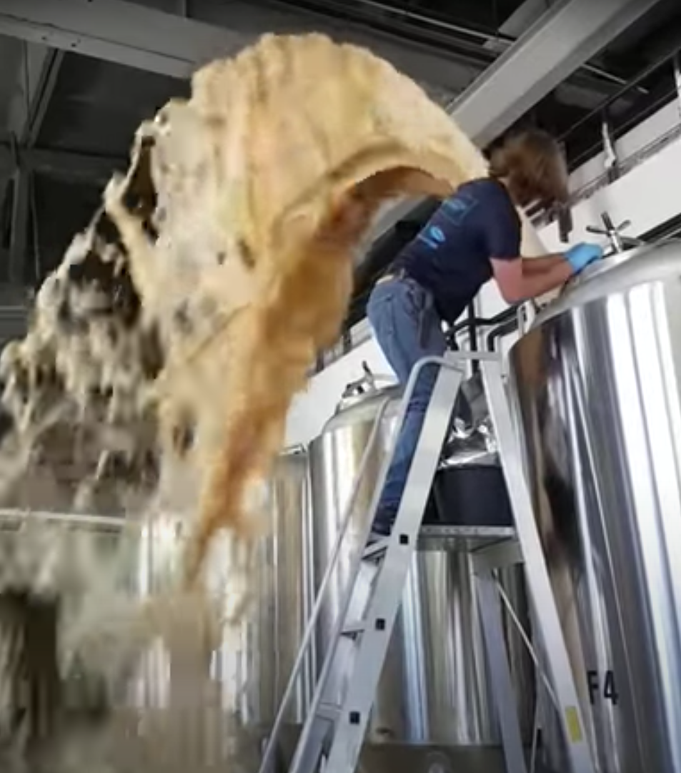
DRY HOPPING
High krausen? I think the aroma gets blown off
n just hop selection.

Slide 33
DRY HOPPING
In terms of aroma (and safety) hops are best dosed under pressure
From above? (See previous photo) Nucleation point, grassy
Recirculating? Shearing hops, risk of oxidation/contamination. Also grassy
Best practice = brink/cannon under pressure
Create a slurry w/ hops & beer and blow in from bottom w/ CO2
5 - 10 g/L
I like NEPA around 5 g/L, IPA around 7 - 8 g/L
10+ g/L works with DIPA but I think there is a law of diminishing returns
Bass and treble varieties
Full/fresh bags

Slide 34
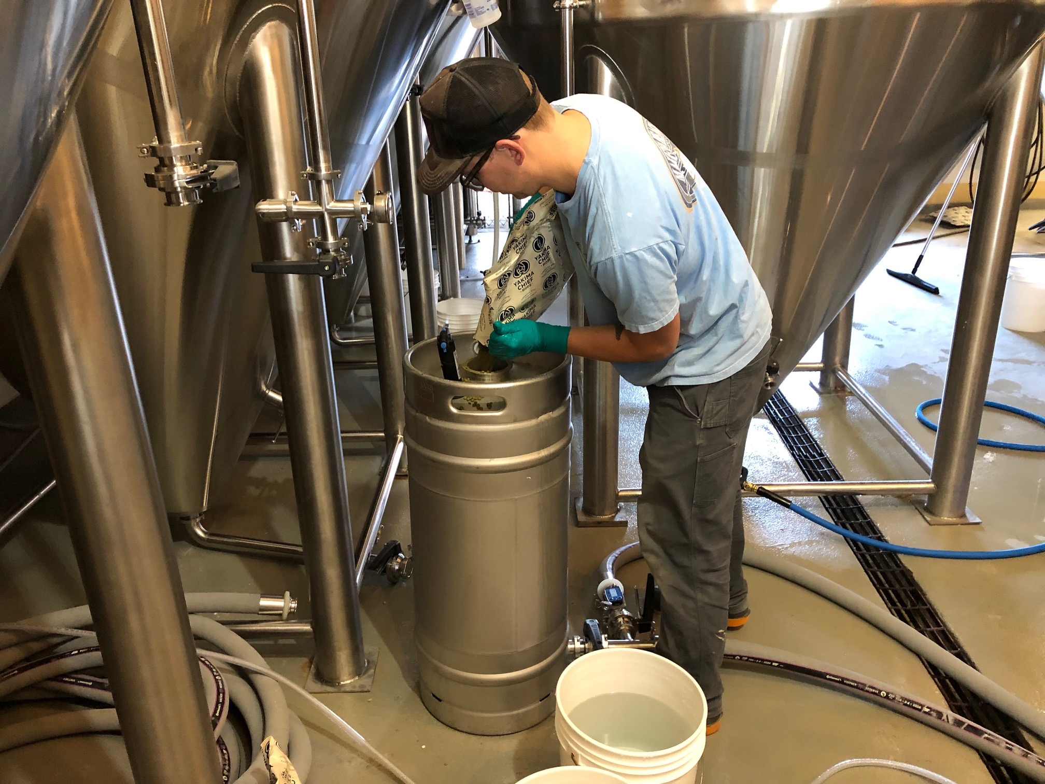
DRY HOPPING

Slide 35
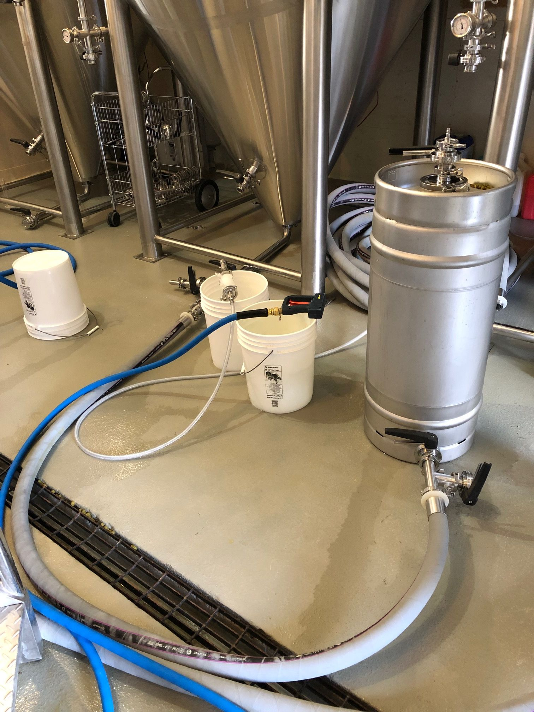
DRY HOPPING

Slide 36
DRY HOPPING - PROCESS
DH then rumble from bottom daily @ 60 psi for 3 days
Bursting = 10 seconds, close-- wait 30 seconds. Repeat x 3
Do a force diacetyl test before crashing
Dose with lactic acid-- find an amount that works for you (beer = <4.40)
Crash by 5 C/day = step crashing
Avoid the dreaded hop slug = dump hops daily
Step down to ~0 C and condition the beer to your liking
Maintain positive pressure in FV
Condition at minimum 1 week
EX: 7 - 10 days fermentation, 3 days DH, 4 - 5 days crashing, condition 7 days
3 - 4 week IPA :)
n just hop selection.

Slide 37
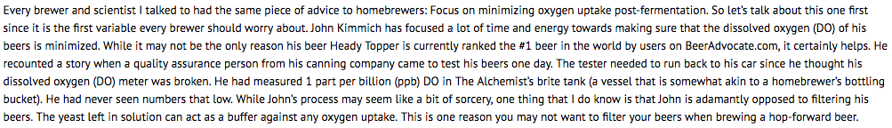
CELLARING / DO
O2 is the enemy of hoppy beer
n just hop selection.

Slide 38
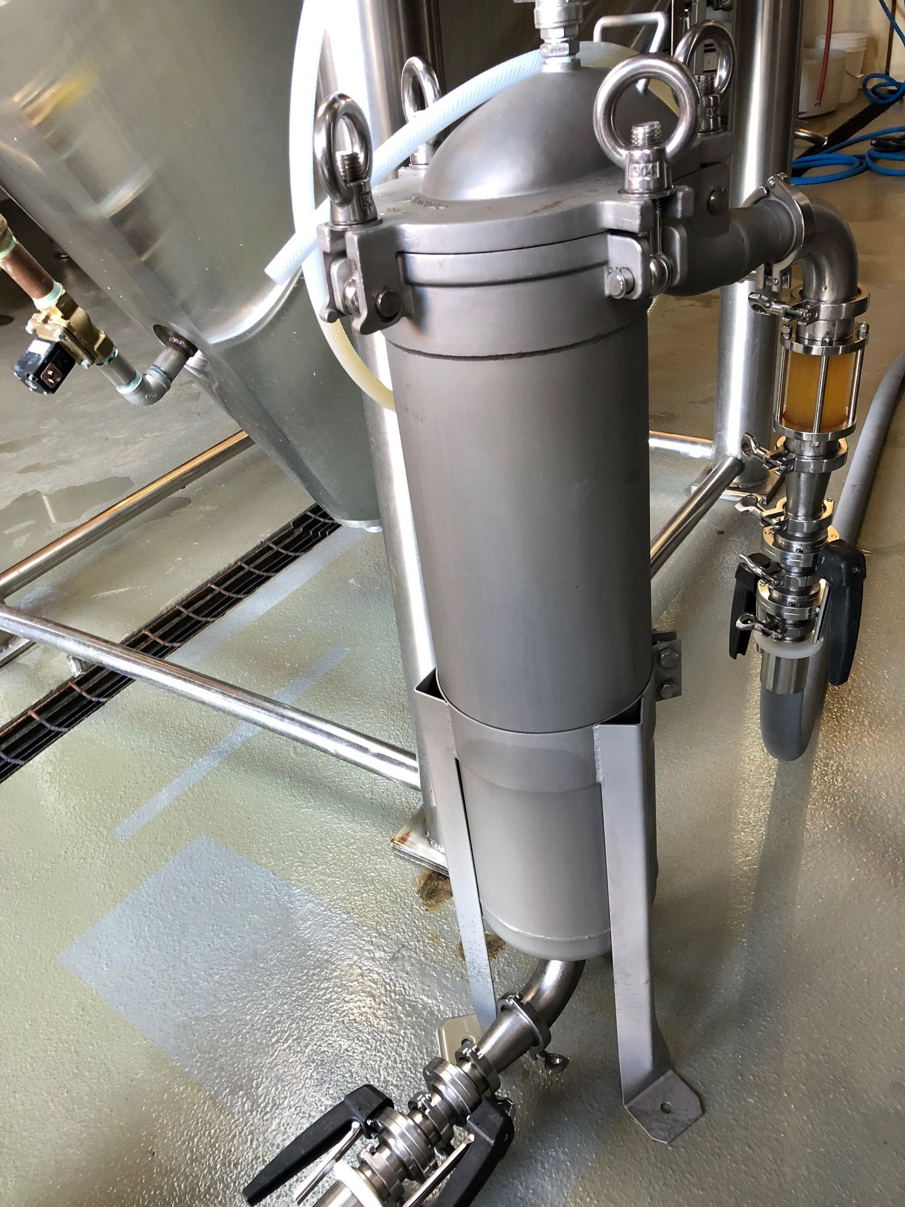
CELLARING / DO
Develop a proper purging SOP for your DH/transfer lines/BBT
Bag filter
Carb level, ~2.50
n just hop selection.

Slide 39
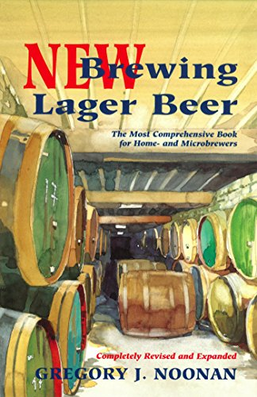
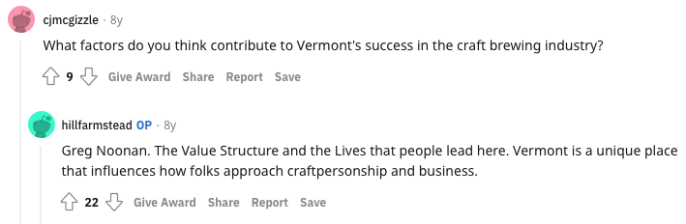
FURTHER READING
Greg Noonan - New Brewing Lager Beer
n just hop selection.

Slide 40
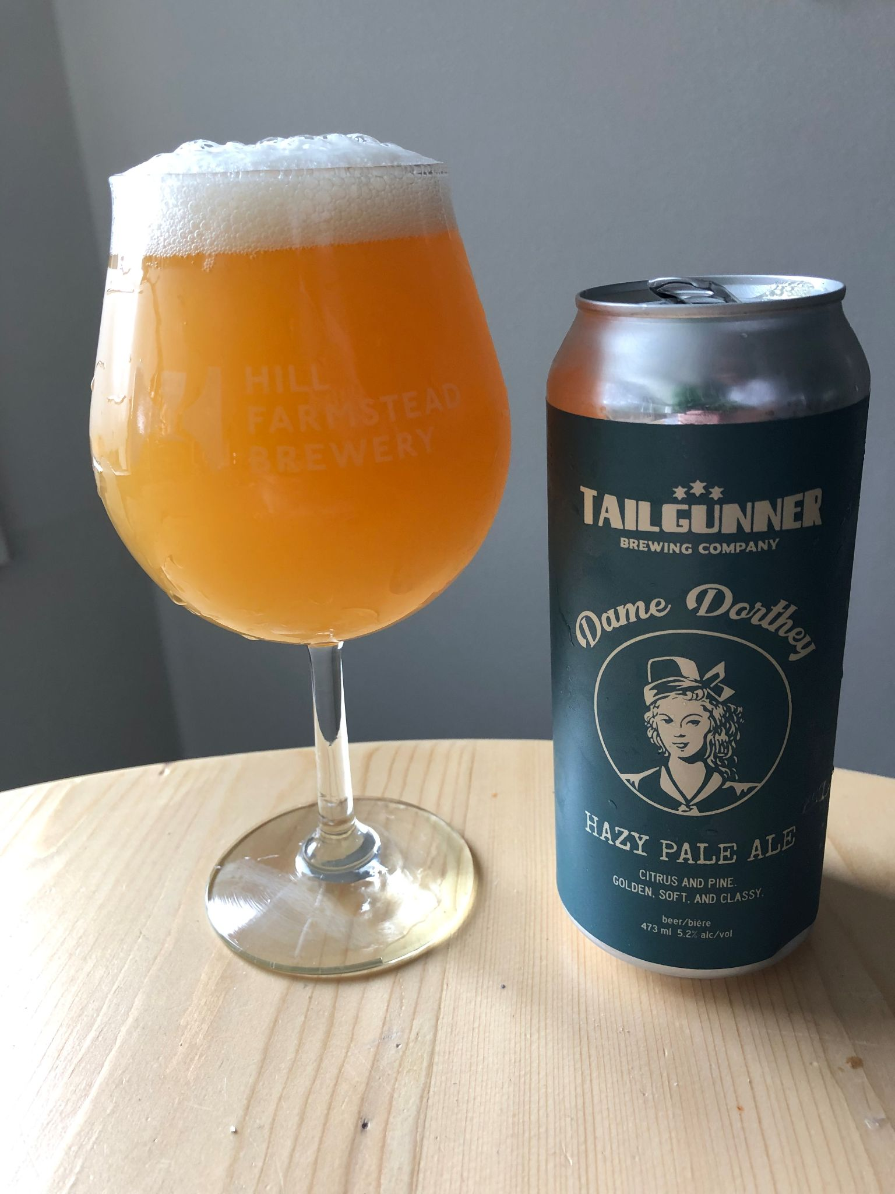
THANK YOU CEBC 2021!

