Slide 1

Combining Lactic Acid Bacteria and ADY (Active Dry Yeasts) for Sour Beer Production
Gilles Goemaere
Technical Sales Support Manager
29/09/2021

Slide 2
Table of Content
Introduction: Sour Beer Production
Kettle-Souring Optimisation: Key Parameters
Beer Characterisation: Sour Wort Fermentation and Organoleptic Profile
Conclusions

Slide 3
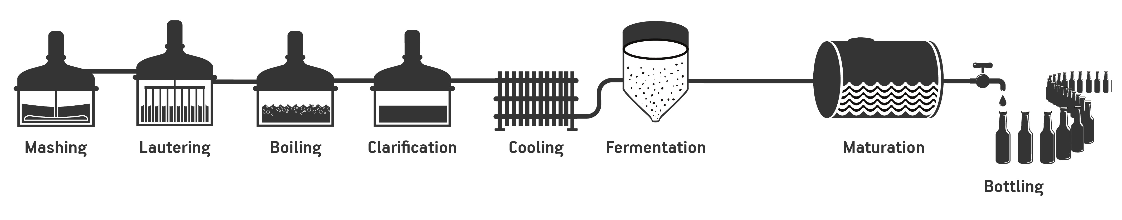
1. Introduction: Kettle-Souring Process
Lambic/Gueuze/Gose beers
Mixed primary fermentation in oak barrel
Bottling
Yeast/Lactobacillus co-inoculation
Berliner Weissbier
< 6 IBU beers
Mixed secondary Fermentation/ Maturation in oak foeders
Malt and Wheat
Malt and Wheat
Blend of Pale Ale and colored malts
Flanders Red Ale beers
Bottling

Slide 4
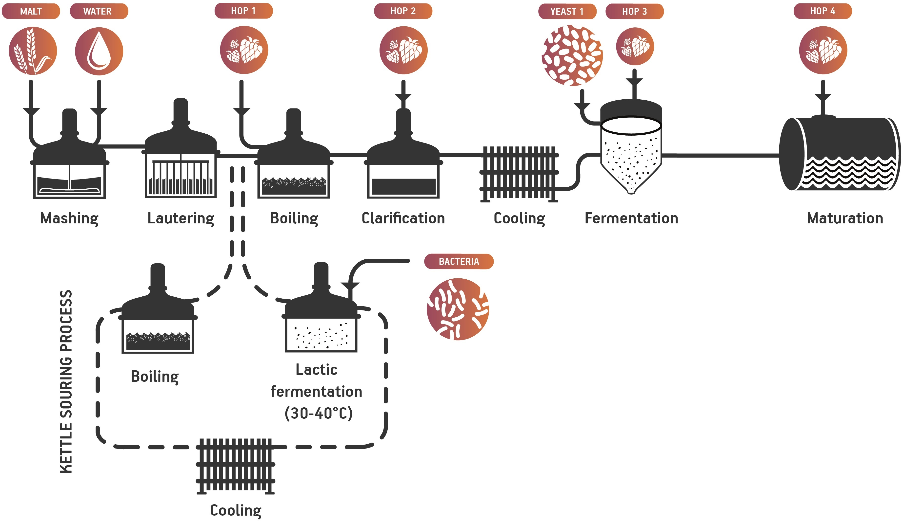
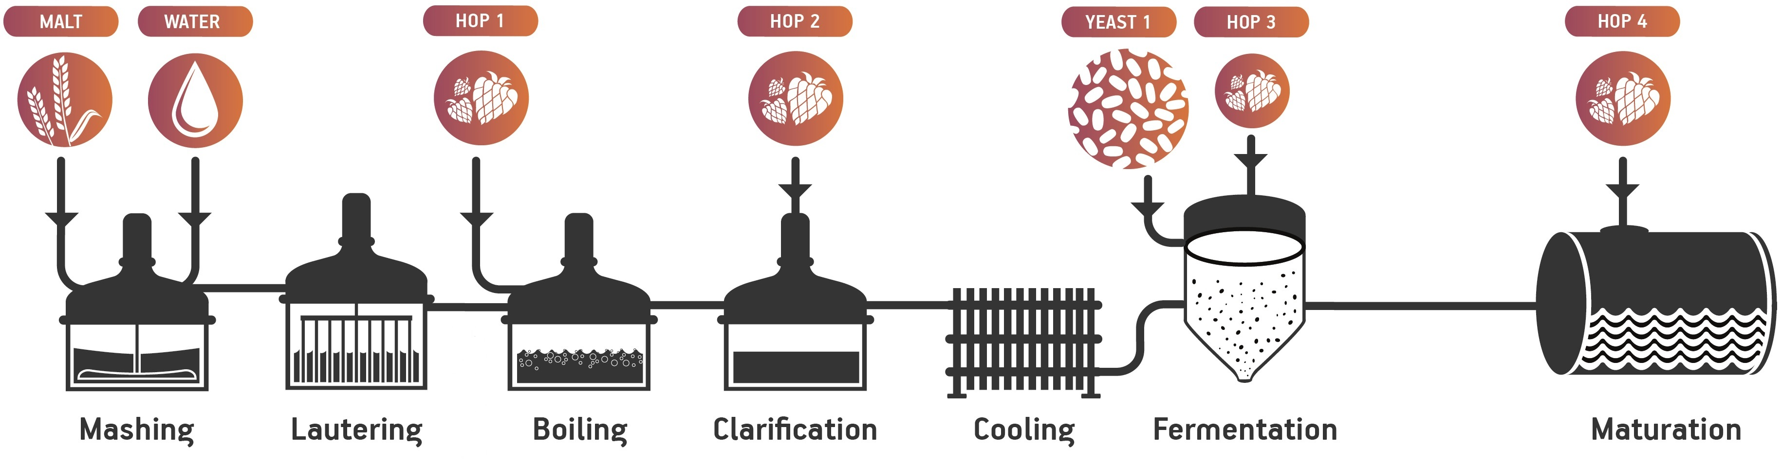
1. Introduction: Kettle-Souring Process

Slide 5
1. Introduction: Fermentative Pathways
HOMOfermentative bacteria
HETEROfermentative bacteria
+ O₂
O₂
Lactiplantibacillus plantarum
Levilactobacillus brevis
SafSour LP 652™
SafSour LB1™
Notes:
Lactiplantibacillus plantarum uses the glycolysis pathway and then the lactic fermentation.
Levilactobacillus brevis uses the phospho gluconate pathway (pentose phosphate pathway), hence the CO2 production when Ribulose -5-P is formed.

Slide 6
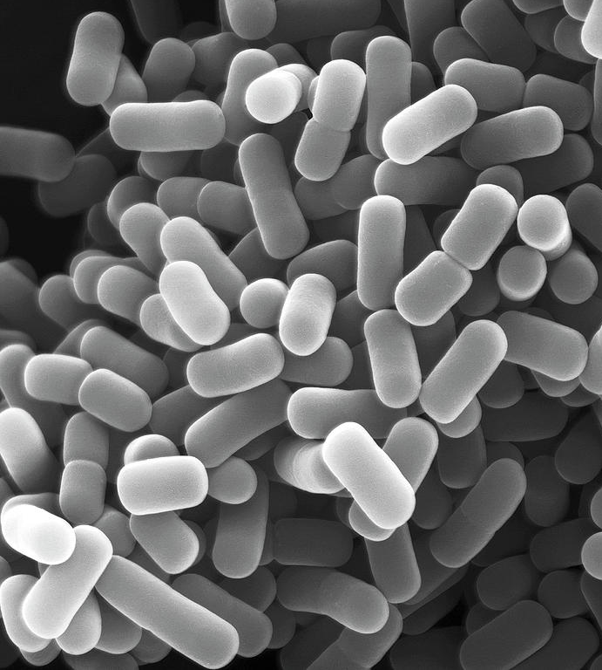
2. Lactic Acid Fermentation Parameters
1 g/hL
8°P
Pitching Rate
°P
10 g/hL
12°P
100 g/hL
16°P
45°C
°C
O₂
Anaerobic
40 °C
30 °C
Aerobic
Lactiplantibacillus plantarum Lp652
Levilactobacillus brevis Lb1
37 °C
Analysis
  Acidification Kinetics
  Organic Acids

Slide 7
2.1. Pitching Rate
1 g/hL
8°P
Pitching Rate
°P
10 g/hL
12°P
100 g/hL
16°P
45°C
°C
O₂
Anaerobic
40 °C
30 °C
Aerobic
Lactiplantibacillus plantarum Lp652
Levilactobacillus brevis Lb1
37 °C
Analysis
  Acidification Kinetics
  Organic Acids

Slide 8
2.1. Pitching Rate - Acidification Kinetics
1 g/hL
Pitching Rate
10 g/hL
100 g/hL
Lp652
Lb1
12°P (non-hopped) – 30°C – Anaerobic
Final pH are lower for Lp652 than for Lb1 at equivalent pitching rate.

Slide 9
2.1. Pitching Rate - Organic Acids
1 g/hL
Pitching Rate
10 g/hL
100 g/hL
Lp652
Lb1
12°P (non-hopped) – 30°C – Anaerobic
Lp652 produces more lactic acid than Lb1
Lb1 produces also acetic acid

Slide 10
2.2. Wort Extract
1 g/hL
8°P
Pitching Rate
°P
10 g/hL
12°P
100 g/hL
16°P
45°C
°C
O₂
Anaerobic
40 °C
30 °C
Aerobic
Lactiplantibacillus plantarum Lp652
Levilactobacillus brevis Lb1
37 °C
Analysis
  Acidification Kinetics
  Organic Acids

Slide 11
2.2. Wort Extract - Acidification Kinetics
°P
8°P
12°P
16°P
Lp652
Lb1
10 g/hL – 30°C – Anaerobic
Slight differences in final pH reached.

Slide 12
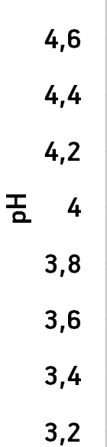
Focus on Wort Buffer Effect
°P
8°P
12°P
16°P
Lp652
Same pH
Different pH
<0.2 g/l
1 g/l

Slide 13
2.2. Wort Extract - Organic Acids
°P
8°P
12°P
16°P
Lb1
10 g/hL – 30°C – Anaerobic
Lp652

Slide 14
2.3. Temperature
1 g/hL
8°P
Pitching Rate
°P
10 g/hL
12°P
100 g/hL
16°P
45°C
°C
O₂
Anaerobic
40 °C
30 °C
Aerobic
Lactiplantibacillus plantarum Lp652
Levilactobacillus brevis Lb1
37 °C
Analysis
  Acidification Kinetics
  Organic Acids

Slide 15
2.3. Temperature - Acidification Kinetics
45°C
°C
40 °C
37 °C
30 °C
Lp652
Lb1
10 g/hL – 12°P (non-hopped) – Anaerobic
Temperatures higher than 37°C impact lactic fermentation performance
for both strains!

Slide 16
2.3. Temperature - Organic Acids
45°C
°C
40 °C
37 °C
30 °C
Lb1
10 g/hL – 12°P (non-hopped) – Anaerobic
Lp652
Temperatures higher than 37°C impact lactic acid production
for both strains!

Slide 17
2.4. Presence of Oxygen
1 g/hL
8°P
Pitching Rate
°P
10 g/hL
12°P
100 g/hL
16°P
45°C
°C
O₂
Anaerobic
40 °C
30 °C
Aerobic
Lactiplantibacillus plantarum Lp652
Levilactobacillus brevis Lb1
37 °C
Analysis
  Acidification Kinetics
  Organic Acids

Slide 18
2.4. Oxygen - Acidification Kinetics
O₂
Anaerobic
Aerobic
Lb1
10 g/hL – 12°P (non-hopped) – 30°C
Lp652
Lactic fermentation is slightly improved in anaerobic conditions.

Slide 19
2.4. Oxygen - Organic Acids Production
O₂
Anaerobic
Aerobic
10 g/hL – 12°P (non-hopped) – 30°C
Acetic acid quantity produced by Lb1 is promoted by aeration conditions.
Notes:
Ratio L/A, the highest, the lowest acetate is in comparison with lactate.
Without O₂ : Lb1 = 3.8 when Lp652= 18
With O₂ : Lb1 = 1.6 when Lp652= 12

Slide 20
2.5 Kettle-Souring - Conclusions
Common Features:
Acidification kinetics are relatively equivalent.
No significative impact of wort density on lactic acid fermentation.
Optimal temperature range: 30°C – 37°C
2) Significant Differences:
Lp652 produces more lactic acid almost exclusively.
Lb1 produces acetic acid in significant quantity;
in addition to lactic acid.
Oxygen presence improves strongly acetic acid production by Lb1.

Slide 21
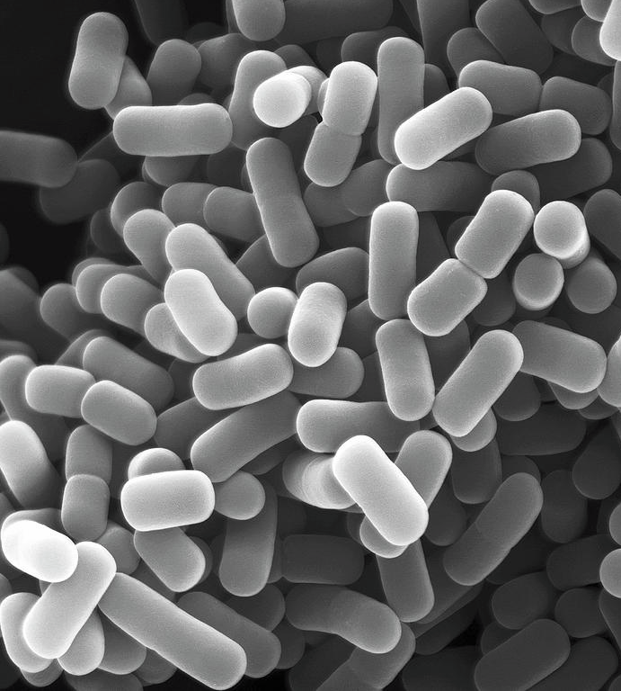
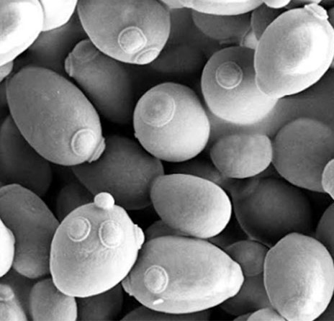

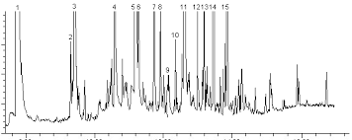

3. Sour Beers Characterisation
Sour Beer Production Protocol
pH
3.5
Pitching Rate
°P
°C
Pitching Rate
100% Pilsen malt
10 g/hL
12°P
°C
O₂
23 °C
50 g/hL
Bacteria Strains
Yeast Strains
30 °C
Anaerobic
Lactic Fermentation
Alcoholic Fermentation
Fermentation Performance
Aromatic Components
Sensory Analysis

Slide 22
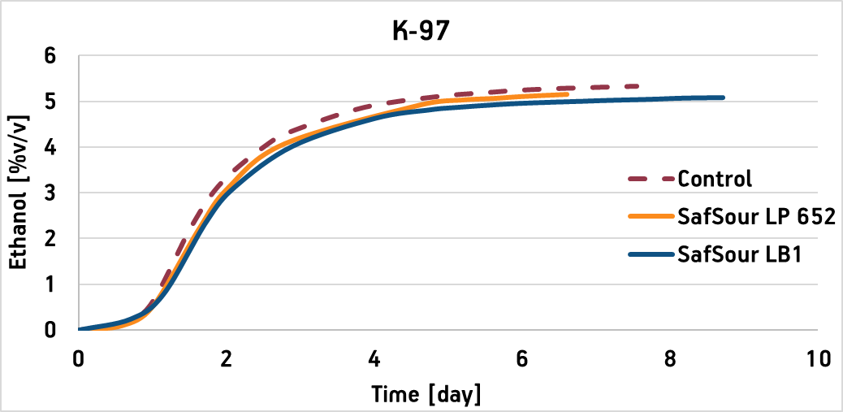
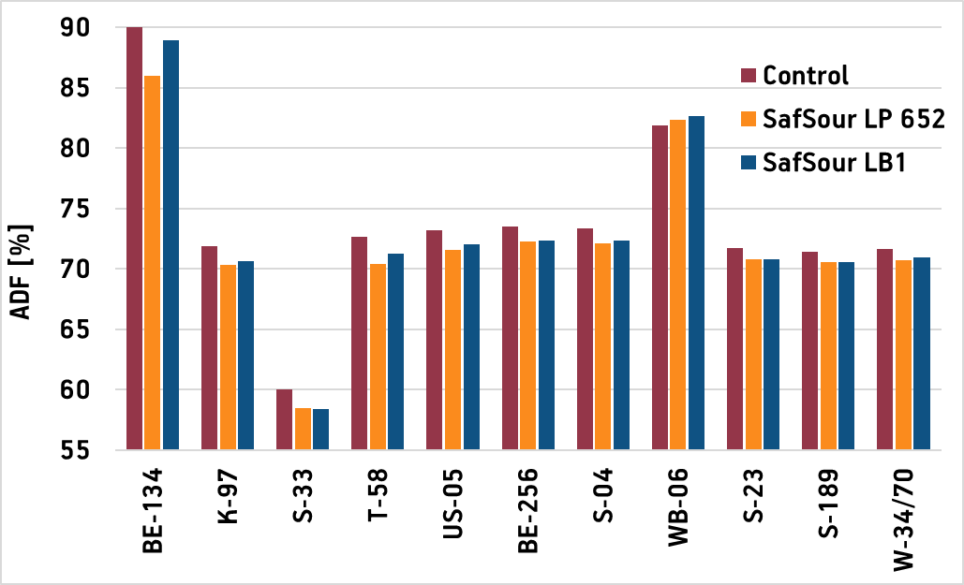
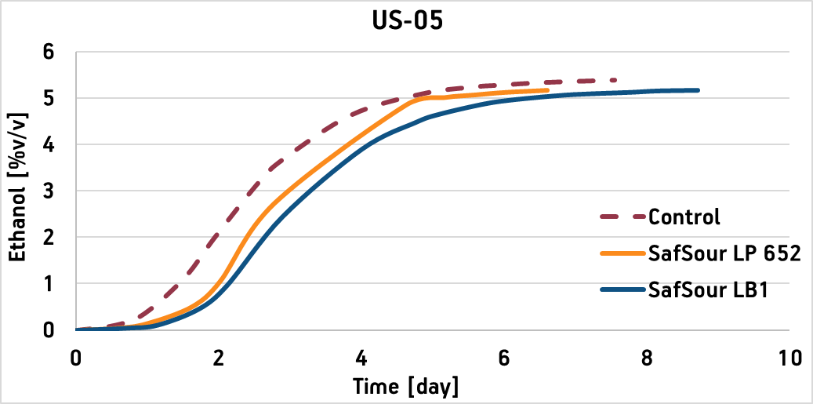
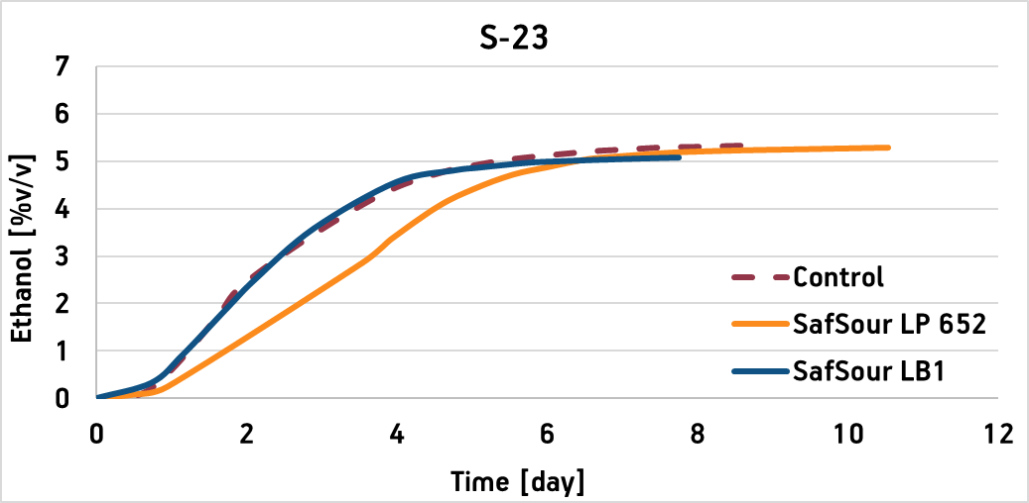
Sour Beers Characterization
3.1. Typical Fermentation Performance
Ale Yeasts i.e.
POF⁻: K-97, S-33, S-04, BE-256
POF⁺: BE-134, T-58, WB-06
Ale Yeasts i.e.
POF⁻: US-05
Lager Yeasts i.e. S-23, W-34/70, S-189

Slide 23
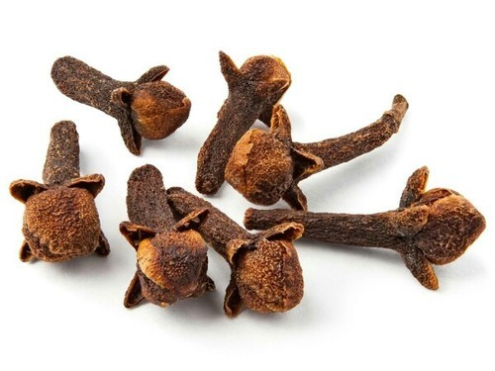

Sour Beers Characterization
3.2. Typical Sensory Profiles
POF⁻
POF⁺
Low POF perception for POF⁺ yeasts when lactic acid fermentation is performed with Lp652.
Lb1 respects phenolic character of POF⁺ yeasts.
Acidity perception is higher with Lp652 than Lb1, increasing drinkability.
Lb1 develops rounder profiles with more balanced organic acid profiles.
POF-
sensory profile with Lp652

Slide 24
Sour Beers Characterization
3.3. Phenolic Aroma Expression
POF+ | 4-VG | 4-EG
Control | + | -
Lp652 | - | -
Lb1 | + | -
No 4-EG detected
Lp652 seems to consume ferulic acid during lactic fermentation.
POF⁺ character of yeast doing the main alcoholic fermentation is not detected, when prior lactic fermentation is performed by Lp652.

Slide 25
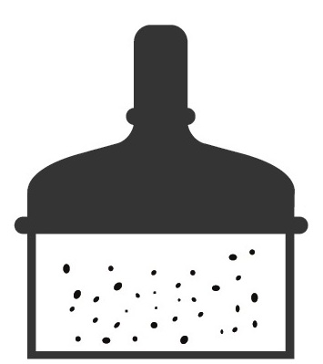
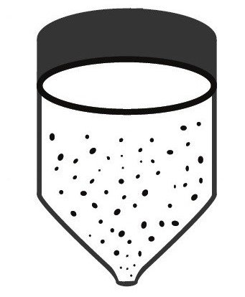
Sour Beers Characterization
3.3. Phenolic Aroma Expression
Lp652 seems to consume ferulic acid during lactic fermentation.
POF⁺ character of yeast doing the main alcoholic fermentation is not detected, when prior lactic fermentation is performed by Lp652.
Summary of what we know.
?
4-VG
Ferulic acid
Ferulic acid
4-VG
4-EG
B. bruxellensis
L. platarum (Lp 652)
L. brevis (Lb 1)
Lactic fermentation
Alcoholic fermentation
POF+ S. cerevisiae
var. disataticus

Slide 26
Conclusions
Sour beer diversity can be created by the LAB strain choice for the lactic fermentation (kettle-souring); more specifically based on:
Quality of the acidity produced during the lactic fermentation, related to relative importance of Lactic Acid (Dairy Character) production vs Acetic Acid (Vinegar Character) production
Lb1 produces acetic acid;
and wort aeration can modulate the amount produced.
Lp652 produces two times more lactic acid than Lb1.

Slide 27
Conclusions
2. Flavor impact of lactic fermentation:
Lb1, due to its aromatic neutrality, respects the yeast flavor/aromatic signature developed during main fermentation.
Lp652 develops citrusy aroma with tropical fruit and peach notes during lactic fermentation.
Lp652 reveals the potential of the fruity expression of the fermentation, more specifically also with POF⁺ yeasts strains by hindering phenolic expression.

