Slide 1
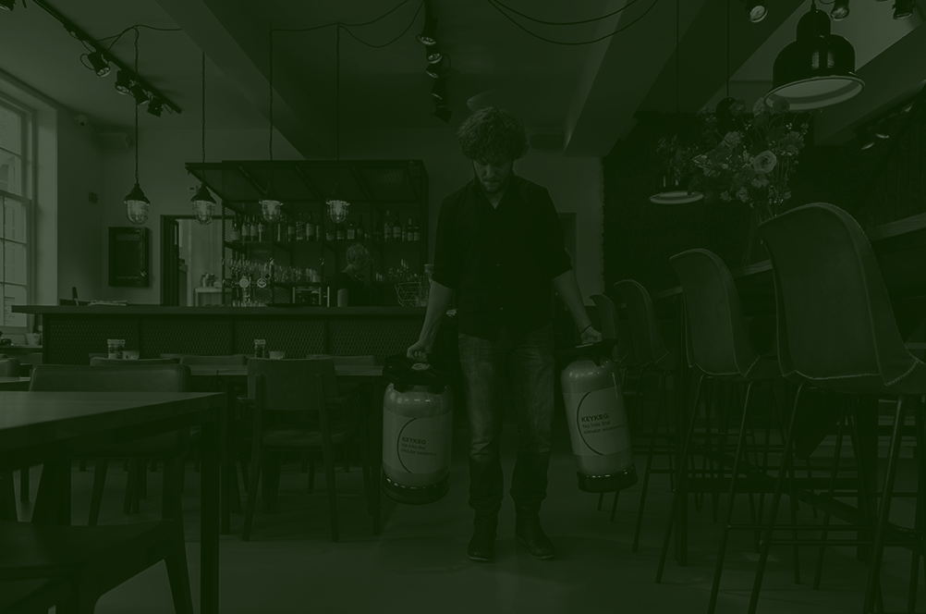
Plastic (Key)Kegs; sustainable packaging?
Michiel de Jager | KeyKeg

Slide 2
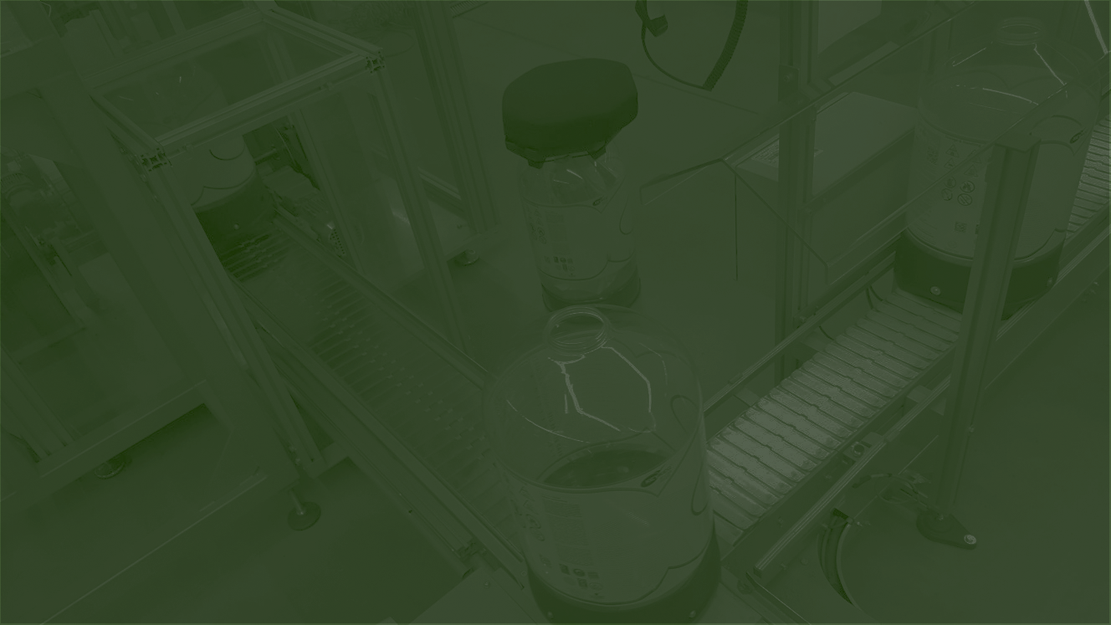
The difference between recyclability and circularity
Notes:
Any business can say it recycles even if it just does the bare minimum. But to be a sustainable business, it is necessary to go beyond just recycling. OneCircle was designed to deliver circularity across its operation. Since its inception, our team have developed products that use mono materials across the KeyKeg® range, aiming to refine the design and increase recyclability along the way. We never stop seeking out efficiencies and have always listened to our customers at every crucial stage of our growth. None of this was an afterthought for us - this was how we envisioned our business from day one.

Slide 3
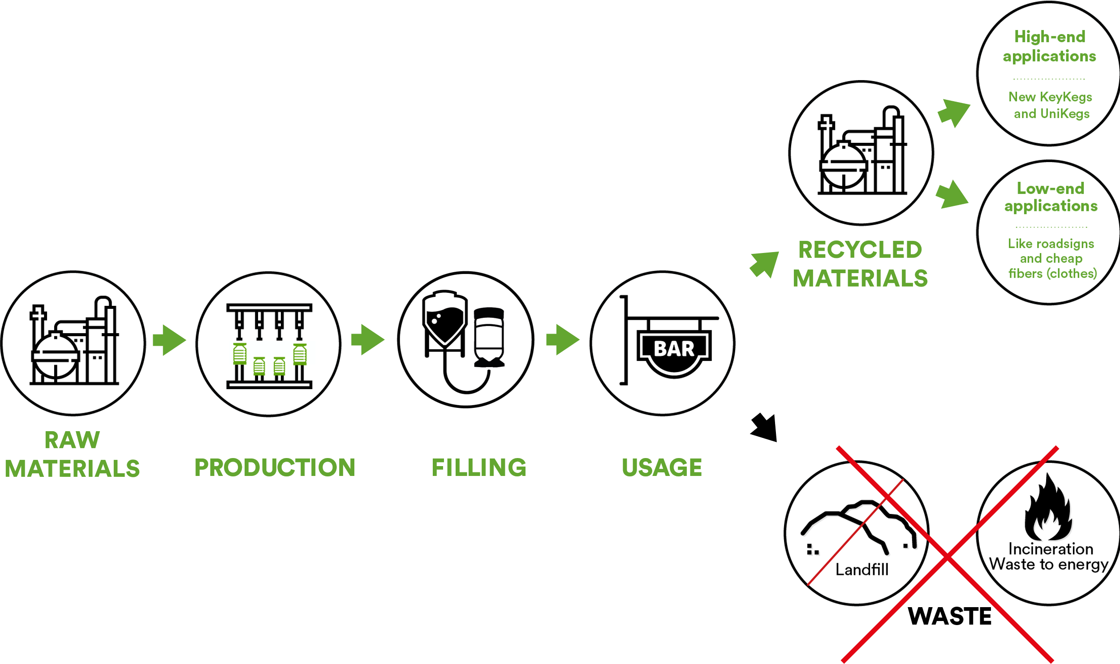
Recycling
Notes:
Any business can say it recycles even if it just does the bare minimum. But to be a sustainable business, it is necessary to go beyond just recycling. OneCircle was designed to deliver circularity across its operation. Since its inception, our team have developed products that use mono materials across the KeyKeg® range, aiming to refine the design and increase recyclability along the way. We never stop seeking out efficiencies and have always listened to our customers at every crucial stage of our growth. None of this was an afterthought for us - this was how we envisioned our business from day one.

Slide 4
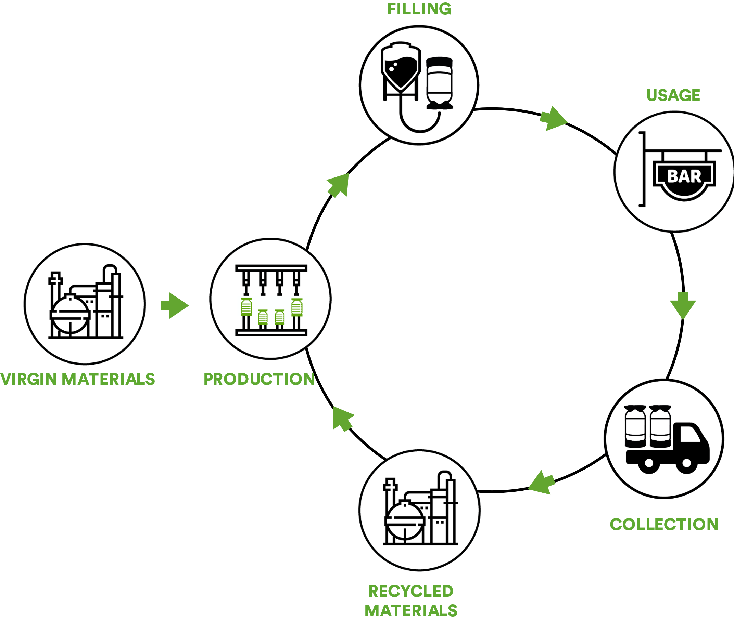
Circular
Notes:
Any business can say it recycles even if it just does the bare minimum. But to be a sustainable business, it is necessary to go beyond just recycling. OneCircle was designed to deliver circularity across its operation. Since its inception, our team have developed products that use mono materials across the KeyKeg® range, aiming to refine the design and increase recyclability along the way. We never stop seeking out efficiencies and have always listened to our customers at every crucial stage of our growth. None of this was an afterthought for us - this was how we envisioned our business from day one.

Slide 5
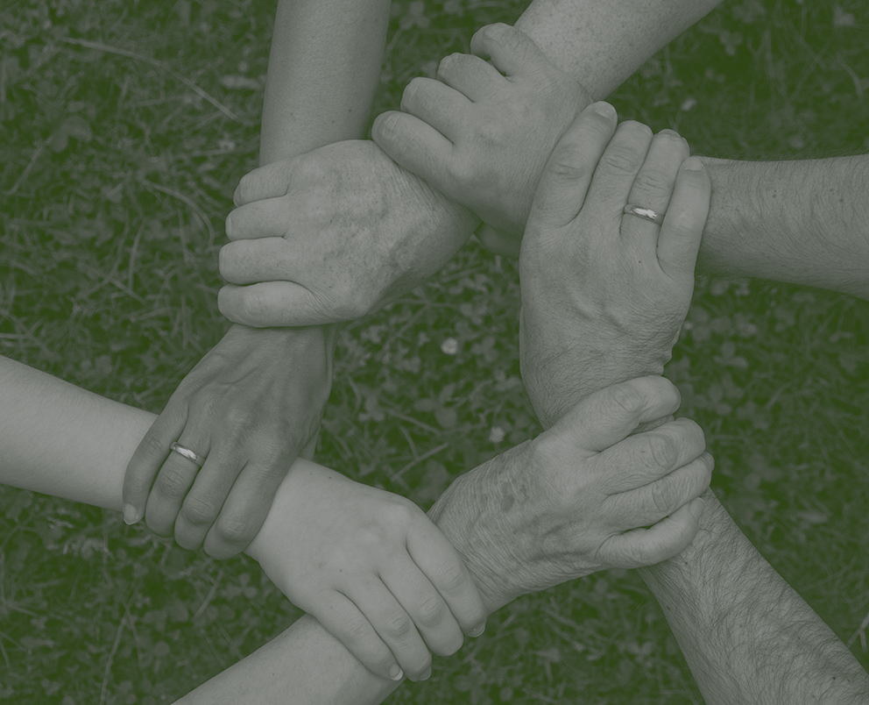
What is a circular economy?
Notes:
A circular economy is an antidote to a linear economy. Instead of things being mined, made and disposed of, things are repeatedly reused. The product/material needs to have been created with recyclability in mind, have an infrastructure in place to keep that product/material in circulation and out of landfill. The current focus of the OneCircle team is to continue building solid working relationships with our collection partners and gain new ones in strategic locations around the world. Offering easy recycling options is key for us, because once in place, this will offer our customers a local way to make a global difference.

Slide 6

How is sustainability measured?
Notes:
This is a crucial point. If a business doesn’t have any way of measuring its environmental impact, it can’t monitor the effects of its actions. To access this information, an extensive database and advanced calculations are necessary. OneCircle uses Ecochain software (! We are switching to SIMA Pro) to tabulate the sustainability of its products and processes. This provides us with an LCA* (Life Cycle Assessment) analysis. OneCircle thinks and acts in terms of the Life Cycle Assessment framework (the only worldwide acknowledged thinking and measuring framework for sustainability). We use this data to benchmark our footprint, which means we can quantify the success of any improvements and pinpoint the areas where more needs to be done.

Slide 7
Life Cycle Assessment analysis
Notes:
This is a crucial point. If a business doesn’t have any way of measuring its environmental impact, it can’t monitor the effects of its actions. To access this information, an extensive database and advanced calculations are necessary. OneCircle uses Ecochain software (! We are switching to SIMA Pro) to tabulate the sustainability of its products and processes. This provides us with an LCA* (Life Cycle Assessment) analysis. OneCircle thinks and acts in terms of the Life Cycle Assessment framework (the only worldwide acknowledged thinking and measuring framework for sustainability). We use this data to benchmark our footprint, which means we can quantify the success of any improvements and pinpoint the areas where more needs to be done.

Slide 8
Does the LCA go beyond measuring footprint?
Notes:
Yes, this methodology incorporates a multitude of product aspects having an environmental impact, such as:
Global Warming Potential (CO2 footprint)
Water usage
Air and water pollution
Depletion of resources
Impact on the ozone layer
Acidification
Eutrophication and more.
To come to a weighted average of all environmental impacts, the Environmental Cost Indicator (ECI) can be used (costs of the environmental damage in represented in Euros). The LCA report provides a comparison with traditional means of beer/wine packaging such as steel kegs, glass bottles and casks. In addition, the report reveals the lowest possible impact of the future 100% circular version of our products, showing that it is superior to traditional packaging in almost all scenarios.

Slide 9






Global Warming Potential
Water usage
Air and water pollution
Impact on the ozone layer
Depletion of rescources
Acidification
And more…
Notes:
Yes, this methodology incorporates a multitude of product aspects having an environmental impact, such as:
Global Warming Potential (CO2 footprint)
Water usage
Air and water pollution
Depletion of resources
Impact on the ozone layer
Acidification
Eutrophication and more.
To come to a weighted average of all environmental impacts, the Environmental Cost Indicator (ECI) can be used (costs of the environmental damage in represented in Euros). The LCA report provides a comparison with traditional means of beer/wine packaging such as steel kegs, glass bottles and casks. In addition, the report reveals the lowest possible impact of the future 100% circular version of our products, showing that it is superior to traditional packaging in almost all scenarios.

Slide 10
Notes:
This is a crucial point. If a business doesn’t have any way of measuring its environmental impact, it can’t monitor the effects of its actions. To access this information, an extensive database and advanced calculations are necessary. OneCircle uses Ecochain software to tabulate the sustainability of its products and processes. This provides us with an LCA* (Life Cycle Assessment) analysis. OneCircle thinks and acts in terms of the Life Cycle Assessment framework (the only worldwide acknowledged thinking and measuring framework for sustainability). We use this data to benchmark our footprint, which means we can quantify the success of any improvements and pinpoint the areas where more needs to be done.

Slide 11
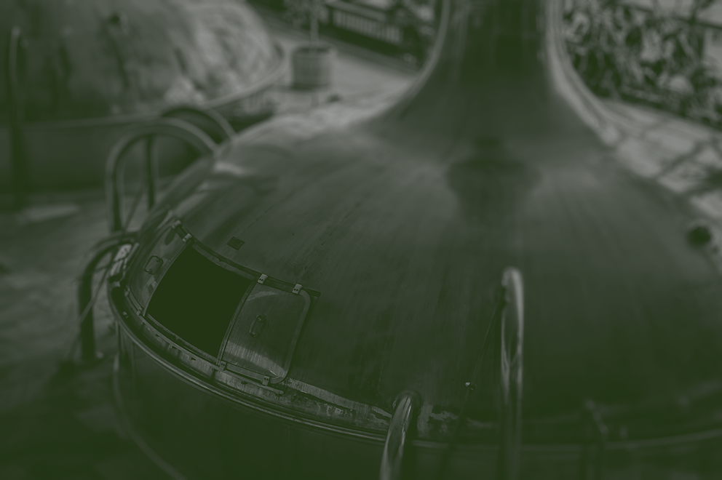
Should the beverage industry still be using plastic at all?
Notes:
The short answer is yes. When it is used as part of a sustainable process, it’s negative image can be cleaned up.
In Europe, 25 million tonnes of plastic are produced every year. Of this, 30% is recycled, 39% is incinerated, and 31% is thrown away in the rubbish (Union*check bron details met Bert, 2018).
Research shows that when plastic packaging is collected and the plastic recycled, it is actually one of the most environmentally friendly packaging options.

Slide 12
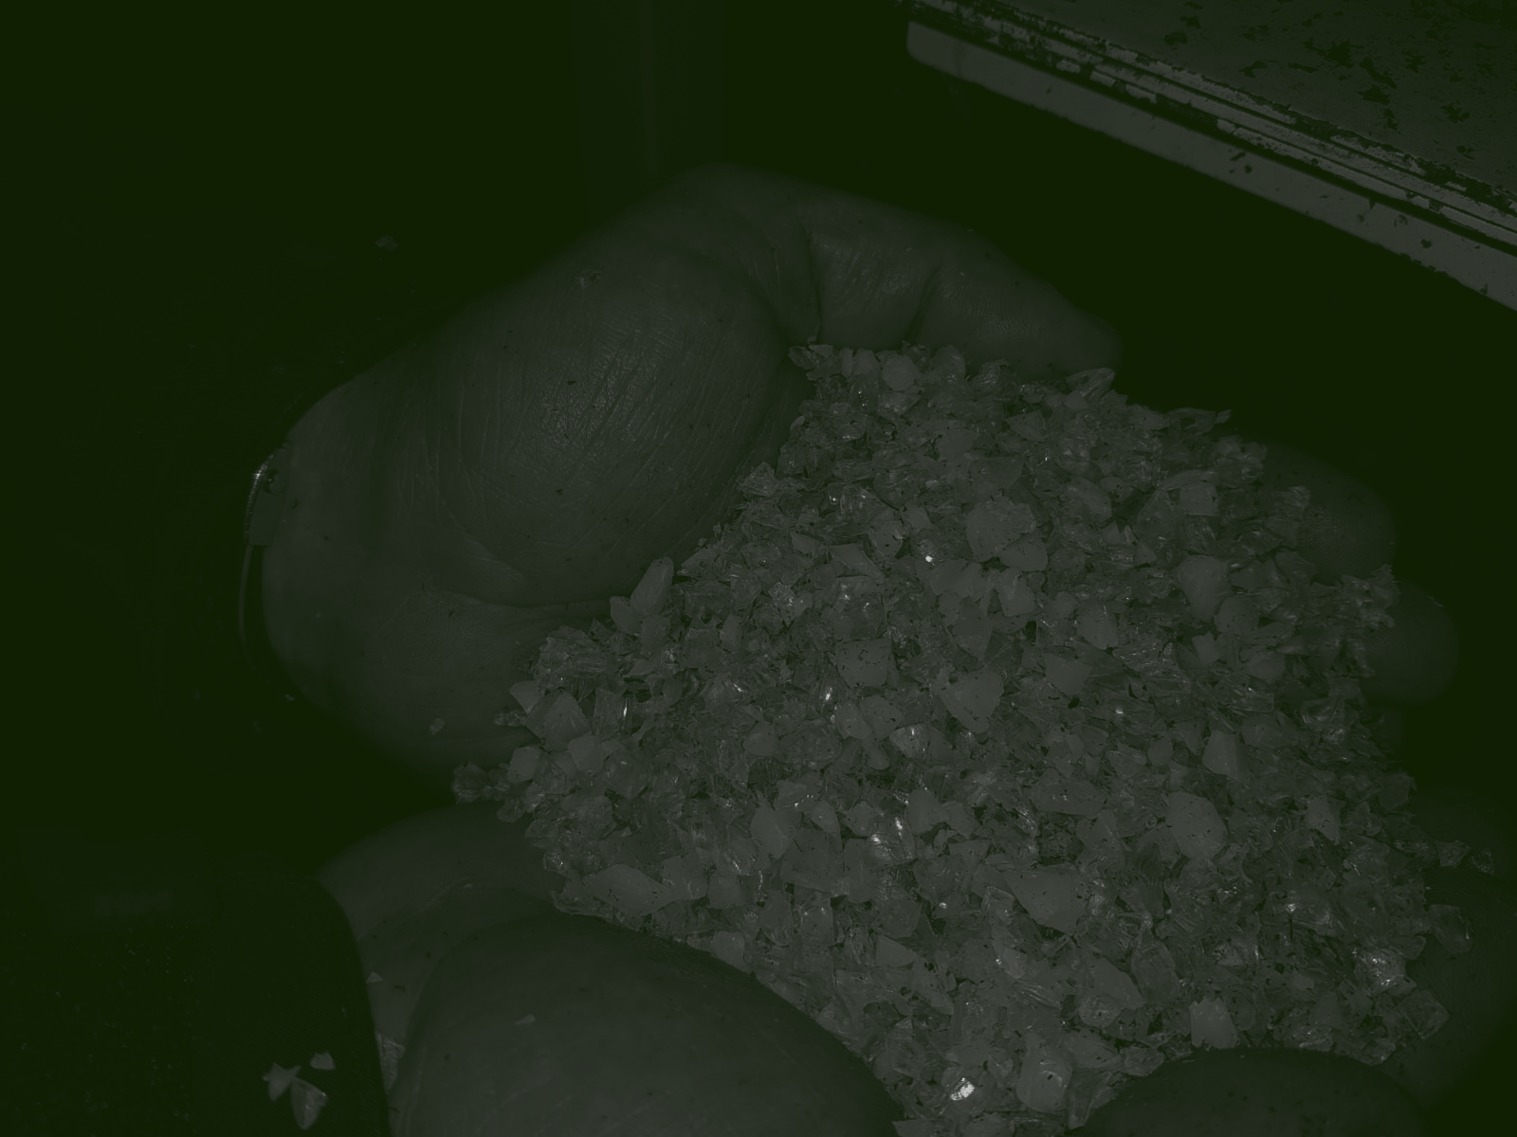
What is PET, and how do you use it?
polyethylene terephthalate
Notes:
OneCircle is the first keg producer to turn used kegs back into raw material for new kegs.
The recycled PET material has been turned into our own brand PET grade: OnePET®. The resin is optimised for being reused in OneCircle's products - KeyKeg® and UniKeg®.
22.5% waste from our factories (post-industrial)
22.5% collected material (post-consumer, collection community)
40% rPET, pet recyclate from PET bottles (purchased material)
15% Virgin PET, new PET (wich is we need for quality reasons) OnePET® consists of 85% recyclate, composed of different streams of PET material.
We are working to put OnePET® into every new production run of KeyKegs® to reach our ultimate mission of a fully circular economy. We don’t just work hard to recycle our product - we aim for closed-loop recycling. Meaning we take ultimate responsibility for where our KeyKegs® go and where they end up.

Slide 13
PET
rPET
OnePET
Polyethylene terephthalate
Recycled polyethylene terephthalate
Recycled polyethylene terephthalate
Optimised for the production
of KeyKegs
Notes:
OneCircle is the first keg producer to turn used kegs back into raw material for new kegs.
The recycled PET material has been turned into our own brand PET grade: OnePET®. The resin is optimised for being reused in OneCircle's products - KeyKeg® and UniKeg®.
22.5% waste from our factories (post-industrial)
22.5% collected material (post-consumer, collection community)
40% rPET, pet recyclate from PET bottles (purchased material)
15% Virgin PET, new PET (wich is we need for quality reasons) OnePET® consists of 85% recyclate, composed of different streams of PET material.
We are working to put OnePET® into every new production run of KeyKegs® to reach our ultimate mission of a fully circular economy. We don’t just work hard to recycle our product - we aim for closed-loop recycling. Meaning we take ultimate responsibility for where our KeyKegs® go and where they end up.

Slide 14
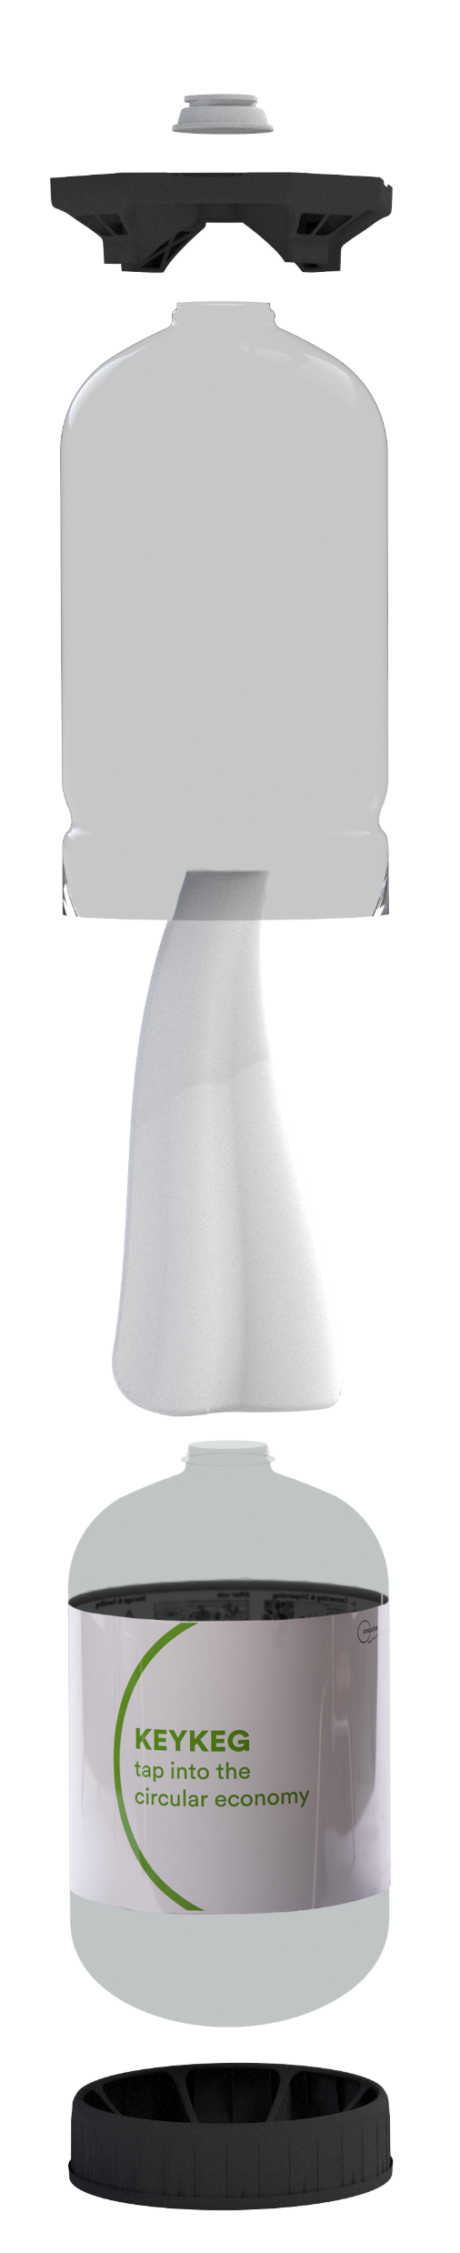
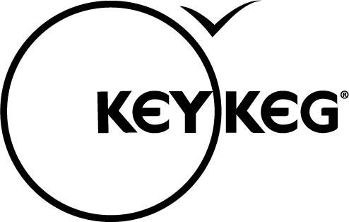
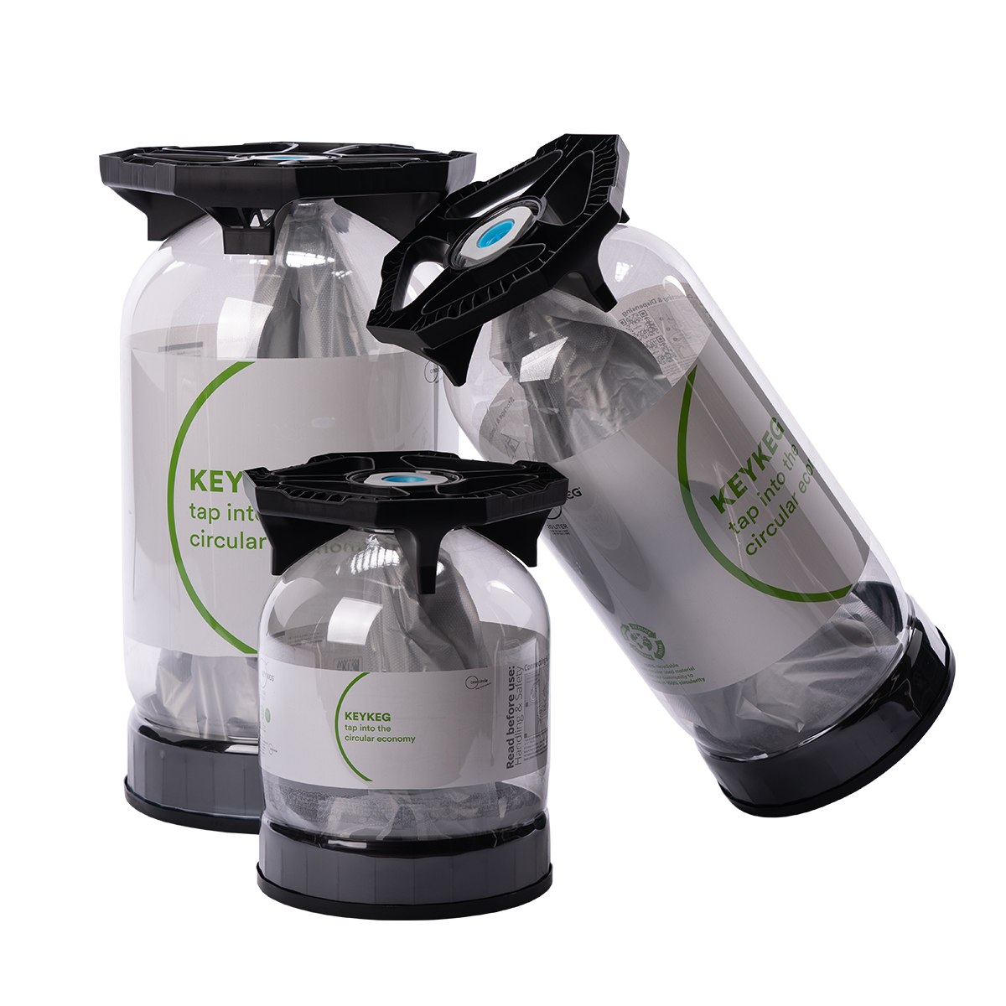
Notes:
OneCircle is the first keg producer to turn used kegs back into raw material for new kegs.
The recycled PET material has been turned into our own brand PET grade: OnePET®. The resin is optimised for being reused in OneCircle's products - KeyKeg® and UniKeg®.

Slide 15

What cost efficiencies can an end-user expect?
Notes:
Any new customer can expect to see savings over a sustained period of supply. Switching to KeyKegs® is not just about environmental wins; it is about economic sustainability across the beverage industry.
The average carbon footprint (cradle2gate) of beer is 275 grams CO₂/ litre. Since the propellant does not come directly into contact with the product, there is no need to use CO₂ or N₂. Air can be used to dispense a KeyKeg®, this will avoid additional production/ transport of CO₂ or N₂.
One 30-litre KeyKeg® holds as much liquid as:
42.9 bottles of wine
3.8 crates of beer in bottles
90.9 cans of beer/mixed drinks
The contents of a KeyKeg® are held in an inner bag. The propellant in a KeyKeg® does not come into direct contact with the product (beer, wine, etc.). The advantage of this is that the propellant does not affect the quality of the product, which dramatically extends the shelf life of a ‘broached’ keg.
The Bag-in-Keg® principle allows the keg to be tapped to virtually the last drop. Kegs using a spear always leave some residual product at the bottom (>200ml), which is always thrown out.
KeyKeg® does not require return transport or cleaning with harsh chemicals. So KeyKeg® saves on return logistics and the cost of the cleaning process too.
The KeyKeg® is a lightweight container for beverages and non-food liquids. The ratio of the KeyKeg’s® weight to the volume of the container is relatively low. Using KeyKeg® gives a more efficient load capacity.

Slide 16
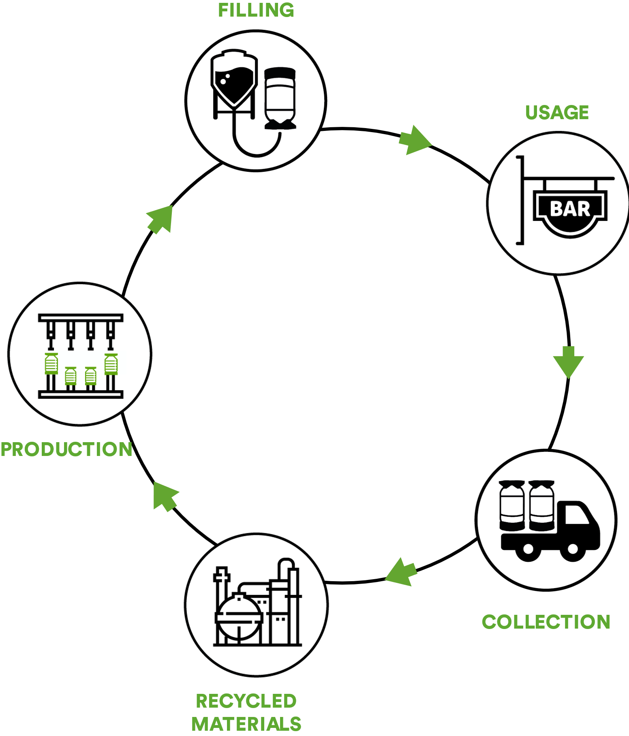
Notes:
Any new customer can expect to see savings over a sustained period of supply. Switching to KeyKegs® is not just about environmental wins; it is about economic sustainability across the beverage industry.
The average carbon footprint (cradle2gate) of beer is 275 grams CO₂/ litre. Since the propellant does not come directly into contact with the product, there is no need to use CO₂ or N₂. Air can be used to dispense a KeyKeg®, this will avoid additional production/ transport of CO₂ or N₂.
One 30-litre KeyKeg® holds as much liquid as:
42.9 bottles of wine
3.8 crates of beer in bottles
90.9 cans of beer/mixed drinks
The contents of a KeyKeg® are held in an inner bag. The propellant in a KeyKeg® does not come into direct contact with the product (beer, wine, etc.). The advantage of this is that the propellant does not affect the quality of the product, which dramatically extends the shelf life of a ‘broached’ keg.
The Bag-in-Keg® principle allows the keg to be tapped to virtually the last drop. Kegs using a spear always leave some residual product at the bottom (>200ml), which is always thrown out.
KeyKeg® does not require return transport or cleaning with harsh chemicals. So KeyKeg® saves on return logistics and the cost of the cleaning process too.
The KeyKeg® is a lightweight container for beverages and non-food liquids. The ratio of the KeyKeg’s® weight to the volume of the container is relatively low. Using KeyKeg® gives a more efficient load capacity.

Slide 17
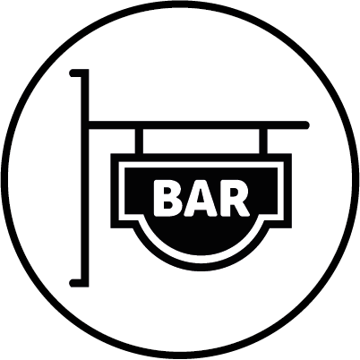
No need to use CO₂ or N₂
Notes:
Any new customer can expect to see savings over a sustained period of supply. Switching to KeyKegs® is not just about environmental wins; it is about economic sustainability across the beverage industry.
The average carbon footprint (cradle2gate) of beer is 275 grams CO₂/ litre. Since the propellant does not come directly into contact with the product, there is no need to use CO₂ or N₂. Air can be used to dispense a KeyKeg®, this will avoid additional production/ transport of CO₂ or N₂.
One 30-litre KeyKeg® holds as much liquid as:
42.9 bottles of wine
3.8 crates of beer in bottles
90.9 cans of beer/mixed drinks
The contents of a KeyKeg® are held in an inner bag. The propellant in a KeyKeg® does not come into direct contact with the product (beer, wine, etc.). The advantage of this is that the propellant does not affect the quality of the product, which dramatically extends the shelf life of a ‘broached’ keg.
The Bag-in-Keg® principle allows the keg to be tapped to virtually the last drop. Kegs using a spear always leave some residual product at the bottom (>200ml), which is always thrown out.
KeyKeg® does not require return transport or cleaning with harsh chemicals. So KeyKeg® saves on return logistics and the cost of the cleaning process too.
The KeyKeg® is a lightweight container for beverages and non-food liquids. The ratio of the KeyKeg’s® weight to the volume of the container is relatively low. Using KeyKeg® gives a more efficient load capacity.

Slide 18
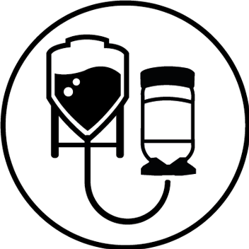
One 30-litre KeyKeg® holds as much liquid as:
- 42.9 bottles of wine
- 3.8 crates of beer bottles
- 90.9 cans of beer mixed drinks
Notes:
Any new customer can expect to see savings over a sustained period of supply. Switching to KeyKegs® is not just about environmental wins; it is about economic sustainability across the beverage industry.
The average carbon footprint (cradle2gate) of beer is 275 grams CO₂/ litre. Since the propellant does not come directly into contact with the product, there is no need to use CO₂ or N₂. Air can be used to dispense a KeyKeg®, this will avoid additional production/ transport of CO₂ or N₂.
One 30-litre KeyKeg® holds as much liquid as:
42.9 bottles of wine
3.8 crates of beer in bottles
90.9 cans of beer/mixed drinks
The contents of a KeyKeg® are held in an inner bag. The propellant in a KeyKeg® does not come into direct contact with the product (beer, wine, etc.). The advantage of this is that the propellant does not affect the quality of the product, which dramatically extends the shelf life of a ‘broached’ keg.
The Bag-in-Keg® principle allows the keg to be tapped to virtually the last drop. Kegs using a spear always leave some residual product at the bottom (>200ml), which is always thrown out.
KeyKeg® does not require return transport or cleaning with harsh chemicals. So KeyKeg® saves on return logistics and the cost of the cleaning process too.
The KeyKeg® is a lightweight container for beverages and non-food liquids. The ratio of the KeyKeg’s® weight to the volume of the container is relatively low. Using KeyKeg® gives a more efficient load capacity.

Slide 19
Extended shelf life
Notes:
Any new customer can expect to see savings over a sustained period of supply. Switching to KeyKegs® is not just about environmental wins; it is about economic sustainability across the beverage industry.
The average carbon footprint (cradle2gate) of beer is 275 grams CO₂/ litre. Since the propellant does not come directly into contact with the product, there is no need to use CO₂ or N₂. Air can be used to dispense a KeyKeg®, this will avoid additional production/ transport of CO₂ or N₂.
One 30-litre KeyKeg® holds as much liquid as:
42.9 bottles of wine
3.8 crates of beer in bottles
90.9 cans of beer/mixed drinks
The contents of a KeyKeg® are held in an inner bag. The propellant in a KeyKeg® does not come into direct contact with the product (beer, wine, etc.). The advantage of this is that the propellant does not affect the quality of the product, which dramatically extends the shelf life of a ‘broached’ keg.
The Bag-in-Keg® principle allows the keg to be tapped to virtually the last drop. Kegs using a spear always leave some residual product at the bottom (>200ml), which is always thrown out.
KeyKeg® does not require return transport or cleaning with harsh chemicals. So KeyKeg® saves on return logistics and the cost of the cleaning process too.
The KeyKeg® is a lightweight container for beverages and non-food liquids. The ratio of the KeyKeg’s® weight to the volume of the container is relatively low. Using KeyKeg® gives a more efficient load capacity.

Slide 20
Dispensing until the very last drop
Notes:
Any new customer can expect to see savings over a sustained period of supply. Switching to KeyKegs® is not just about environmental wins; it is about economic sustainability across the beverage industry.
The average carbon footprint (cradle2gate) of beer is 275 grams CO₂/ litre. Since the propellant does not come directly into contact with the product, there is no need to use CO₂ or N₂. Air can be used to dispense a KeyKeg®, this will avoid additional production/ transport of CO₂ or N₂.
One 30-litre KeyKeg® holds as much liquid as:
42.9 bottles of wine
3.8 crates of beer in bottles
90.9 cans of beer/mixed drinks
The contents of a KeyKeg® are held in an inner bag. The propellant in a KeyKeg® does not come into direct contact with the product (beer, wine, etc.). The advantage of this is that the propellant does not affect the quality of the product, which dramatically extends the shelf life of a ‘broached’ keg.
The Bag-in-Keg® principle allows the keg to be tapped to virtually the last drop. Kegs using a spear always leave some residual product at the bottom (>200ml), which is always thrown out.
KeyKeg® does not require return transport or cleaning with harsh chemicals. So KeyKeg® saves on return logistics and the cost of the cleaning process too.
The KeyKeg® is a lightweight container for beverages and non-food liquids. The ratio of the KeyKeg’s® weight to the volume of the container is relatively low. Using KeyKeg® gives a more efficient load capacity.

Slide 21
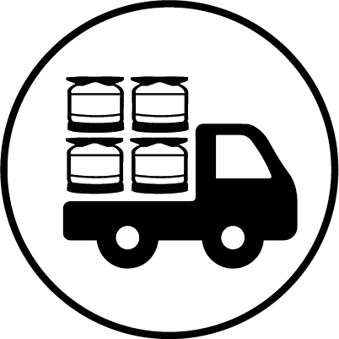
Local for local recycling
Notes:
Any new customer can expect to see savings over a sustained period of supply. Switching to KeyKegs® is not just about environmental wins; it is about economic sustainability across the beverage industry.
The average carbon footprint (cradle2gate) of beer is 275 grams CO₂/ litre. Since the propellant does not come directly into contact with the product, there is no need to use CO₂ or N₂. Air can be used to dispense a KeyKeg®, this will avoid additional production/ transport of CO₂ or N₂.
One 30-litre KeyKeg® holds as much liquid as:
42.9 bottles of wine
3.8 crates of beer in bottles
90.9 cans of beer/mixed drinks
The contents of a KeyKeg® are held in an inner bag. The propellant in a KeyKeg® does not come into direct contact with the product (beer, wine, etc.). The advantage of this is that the propellant does not affect the quality of the product, which dramatically extends the shelf life of a ‘broached’ keg.
The Bag-in-Keg® principle allows the keg to be tapped to virtually the last drop. Kegs using a spear always leave some residual product at the bottom (>200ml), which is always thrown out.
KeyKeg® does not require return transport or cleaning with harsh chemicals. So KeyKeg® saves on return logistics and the cost of the cleaning process too.
The KeyKeg® is a lightweight container for beverages and non-food liquids. The ratio of the KeyKeg’s® weight to the volume of the container is relatively low. Using KeyKeg® gives a more efficient load capacity.

Slide 22
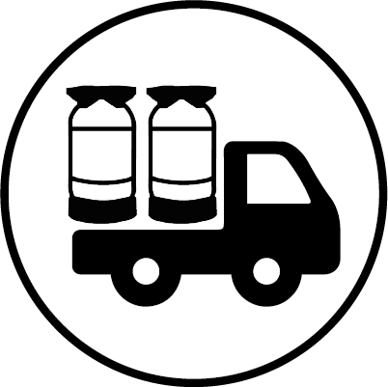
More efficient load capacity
Notes:
Any new customer can expect to see savings over a sustained period of supply. Switching to KeyKegs® is not just about environmental wins; it is about economic sustainability across the beverage industry.
With a new, UK-based warehouse, there is now a fast and reliable supply of the KeyKeg® product range for the busy British market. With overseas shipping times and associated costs reduced, we are able to offer a far more competitive and responsive service within England and Wales.
The average carbon footprint (cradle2gate) of beer is 275 grams CO₂/ litre. Since the propellant does not come directly into contact with the product, there is no need to use CO₂ or N₂. Air can be used to dispense a KeyKeg®, this will avoid additional production/ transport of CO₂ or N₂.
One 30-litre KeyKeg® holds as much liquid as:
42.9 bottles of wine
3.8 crates of beer in bottles
90.9 cans of beer/mixed drinks
The contents of a KeyKeg® are held in an inner bag. The propellant in a KeyKeg® does not come into direct contact with the product (beer, wine, etc.). The advantage of this is that the propellant does not affect the quality of the product, which dramatically extends the shelf life of a ‘broached’ keg.
The Bag-in-Keg® principle allows the keg to be tapped to virtually the last drop. Kegs using a spear always leave some residual product at the bottom (>200ml), which is always thrown out.
KeyKeg® does not require return transport or cleaning with harsh chemicals. So KeyKeg® saves on return logistics and the cost of the cleaning process too.
The KeyKeg® is a lightweight container for beverages and non-food liquids. The ratio of the KeyKeg’s® weight to the volume of the container is relatively low. Using KeyKeg® gives a more efficient load capacity.

Slide 23
Light weight, so easier handling
Notes:
Any new customer can expect to see savings over a sustained period of supply. Switching to KeyKegs® is not just about environmental wins; it is about economic sustainability across the beverage industry.
With a new, UK-based warehouse, there is now a fast and reliable supply of the KeyKeg® product range for the busy British market. With overseas shipping times and associated costs reduced, we are able to offer a far more competitive and responsive service within England and Wales.
The average carbon footprint (cradle2gate) of beer is 275 grams CO₂/ litre. Since the propellant does not come directly into contact with the product, there is no need to use CO₂ or N₂. Air can be used to dispense a KeyKeg®, this will avoid additional production/ transport of CO₂ or N₂.
One 30-litre KeyKeg® holds as much liquid as:
42.9 bottles of wine
3.8 crates of beer in bottles
90.9 cans of beer/mixed drinks
The contents of a KeyKeg® are held in an inner bag. The propellant in a KeyKeg® does not come into direct contact with the product (beer, wine, etc.). The advantage of this is that the propellant does not affect the quality of the product, which dramatically extends the shelf life of a ‘broached’ keg.
The Bag-in-Keg® principle allows the keg to be tapped to virtually the last drop. Kegs using a spear always leave some residual product at the bottom (>200ml), which is always thrown out.
KeyKeg® does not require return transport or cleaning with harsh chemicals. So KeyKeg® saves on return logistics and the cost of the cleaning process too.
The KeyKeg® is a lightweight container for beverages and non-food liquids. The ratio of the KeyKeg’s® weight to the volume of the container is relatively low. Using KeyKeg® gives a more efficient load capacity.

Slide 24

What currently happens to used KeyKegs?
Notes:
At what would have been the end-of-life stage for a keg, our KeyKegs® are only just beginning their journey. The dispensed kegs can be crushed into bails either as partly separated or complete kegs. OneCircle pays the collection partner a price per tonne for the material collected.
The bails are collected by our collection partners, where the kegs will be dismantled and PET separated, so that the materials can be reused to production of new KeyKegs®.
Partners can choose to partly dismantle the kegs into the primary mono materials PET and PP while the bag and fittings can go into the local waste stream or bale the whole keg.

Slide 25
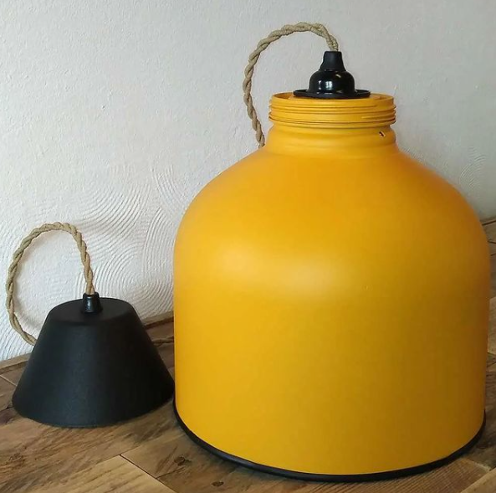
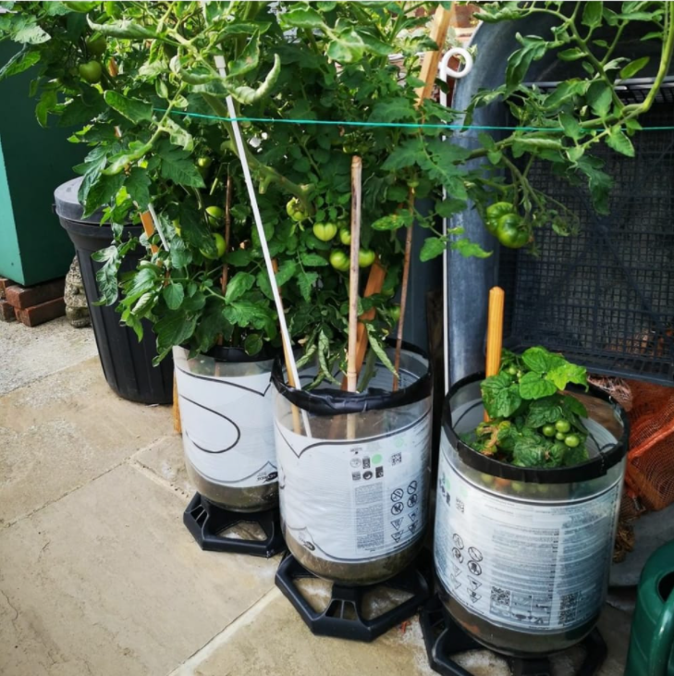
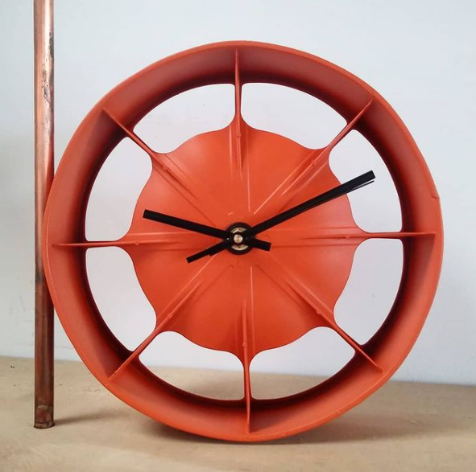
Notes:
At what would have been the end-of-life stage for a keg, our KeyKegs® are only just beginning their journey. The dispensed kegs can be crushed into bails either as partly separated or complete kegs. OneCircle pays the collection partner a price per tonne for the material collected.
The bails are collected by our collection partners, where the kegs will be dismantled and PET separated, so that the materials can be reused to production of new KeyKegs®.
Partners can choose to partly dismantle the kegs into the primary mono materials PET and PP while the bag and fittings can go into the local waste stream or bale the whole keg.

Slide 26
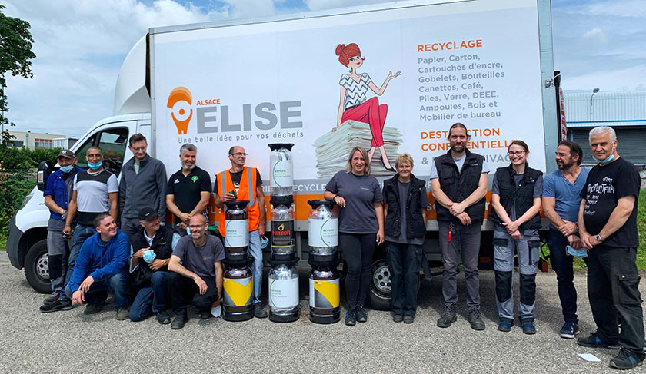
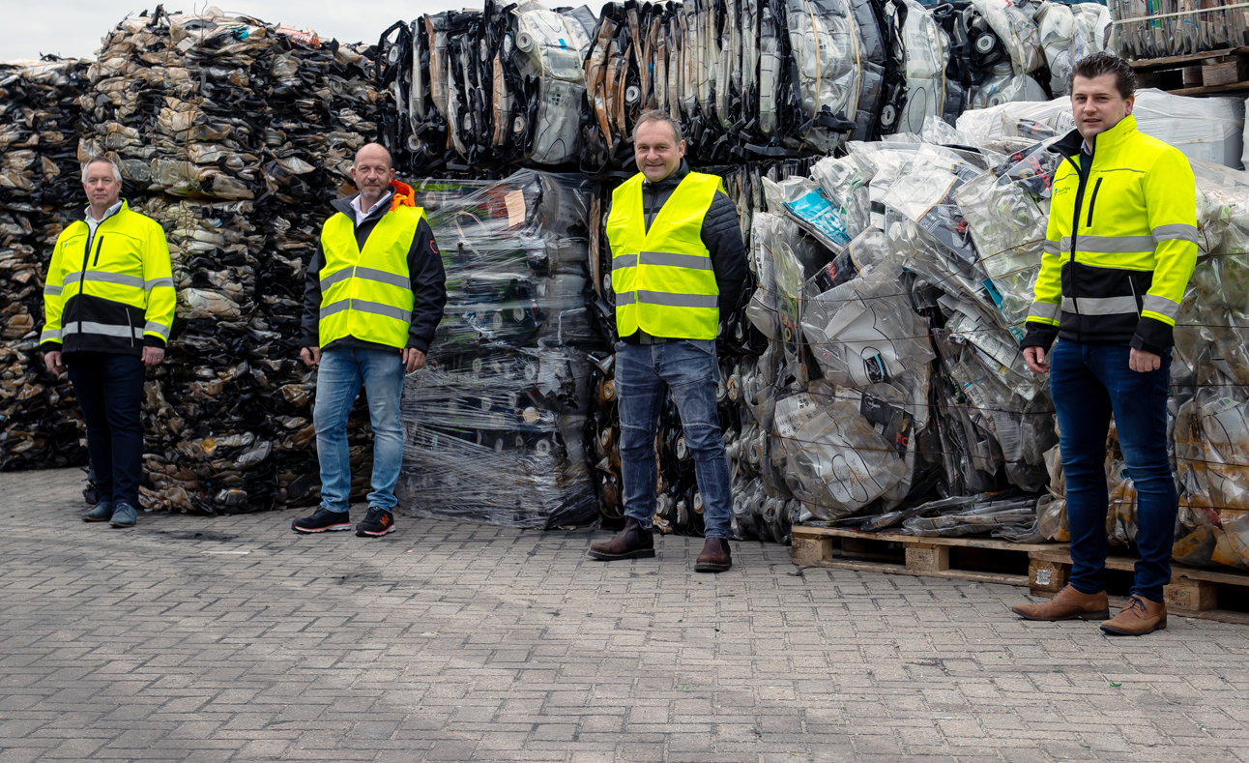
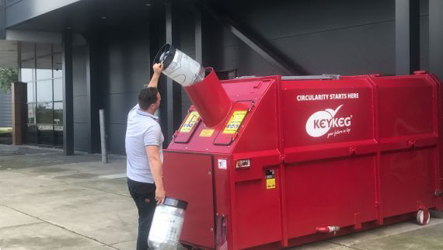
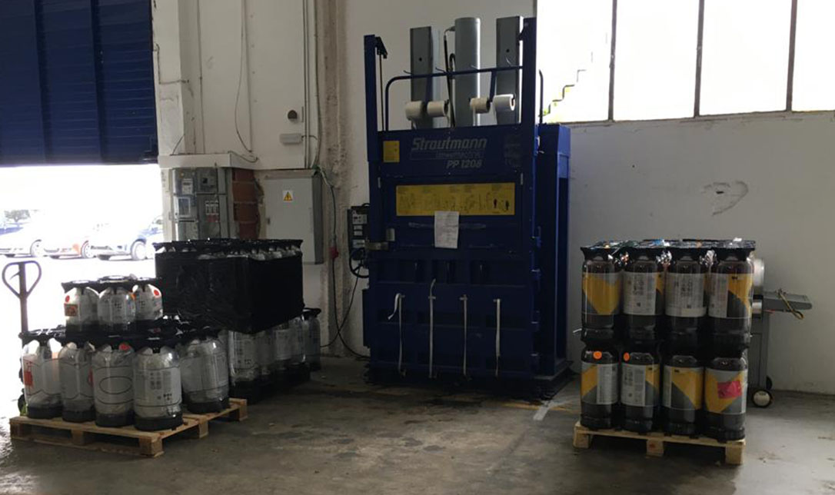
Notes:
At what would have been the end-of-life stage for a keg, our KeyKegs® are only just beginning their journey. The dispensed kegs can be crushed into bails either as partly separated or complete kegs. OneCircle pays the collection partner a price per tonne for the material collected.
The bails are collected by our collection partners, where the kegs will be dismantled and PET separated, so that the materials can be reused to production of new KeyKegs®.
Partners can choose to partly dismantle the kegs into the primary mono materials PET and PP while the bag and fittings can go into the local waste stream or bale the whole keg.

Slide 27
