Slide 1
Solutions for low alcohol beer
CEBC - 2021

Slide 2
Low or no alcohol beer – common criticisms
Beers are overly sweet
Beers are worty
Beers are thin and lack mouthfeel
How do we over come these criticisms to create a drinkable beer?

Slide 3
Creating a great tasting low or no alcohol beer requires a holistic approach to both wort and beer creation. All parts make up the whole and must be considered when designing low alcohol beers.
Great tasting low or no alcohol beer
Wort Production and design
Fermentation Method
Choice of Organism
Alcohol removal or dilution
pH correction
Stabilisation

Slide 4
Understand the importance of wort composition in recipe design
% of normal wort sugars
Glucose DP1
10-15
Maltose DP2
50-60
Maltotriose DP3
15-20
+
Dextrin DP4+
20-30
Notes:
Under normal circumstances brewers wort is made up of anywhere between 75% and 95% fermentable sugar. Yeast in the presence of fermentable sugar creates alcohol. In order to create less alcohol we need either reduce the concentration of fermentable sugars in the wort, use a yeast unable to consume all the sugars, or a combination of the two techniques

Slide 5
Understand mash enzymes and modify your fermentability
brewers window
low alc window
Key
More of this
beta amylase
Enzyme activity
=
Less of this
alpha amylase
CH₃CH₂OH
fermentability
64-70⁰C
76-82⁰C
Temperature
Notes:
The mashing process relies on two enzymes, beta amylase and alpha amylase. A normal mash aims to maximise starch breakdown by activating both enzymes near their optimum temperature, the so called brewers window. The fermentability of wort can be skewed in favour of being less fermentable by mashing in at higher temperatures to avoid beta amylase activity this is the low alcohol window.

Slide 6
Some experimental work with high mashing technique

Slide 7
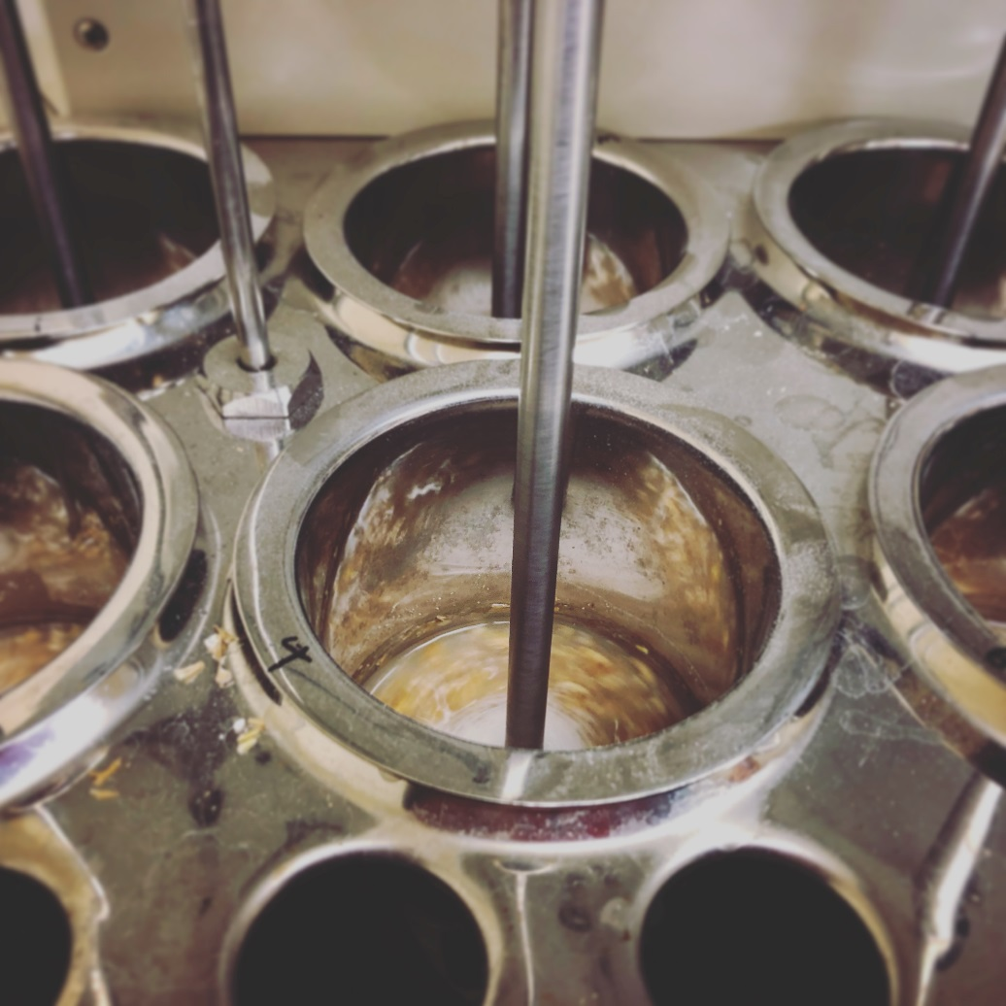
Mash temperature Trials
Idea is to inactivate beta amylase while keeping alpha amylase active
5 different single mash temperatures
Four time periods
7.5 Plato wort
Notes:
Formed the basis of an experiment.

Slide 8
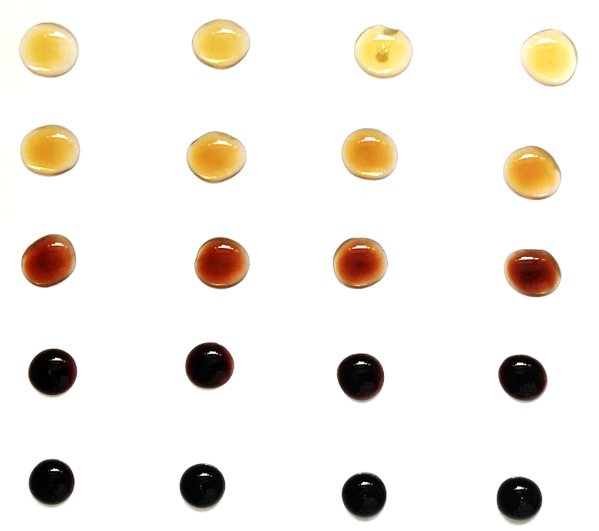
AB Vickers Trials (mash bath + iodine)
Initial mashing regime
Iodine test
60
70
80
90
 |  | Mash Temperature ⁰C
 |  | 74 | 78 | 82 | 86 | 95
Mash Time (min) | 60 | S1 | S5 | S9 | S13 | S17
 | 70 | S2 | S6 | S10 | S14 | S18
 | 80 | S3 | S7 | S11 | S15 | S19
 | 90 | S4 | S8 | S12 | S16 | S20
74
78
82
86
95
Notes:
The initial experimental procedure. Amylopectin and starch will stain black with iodine while dextrin and erythrodextrin material will stain red

Slide 9
Mascoma analysis (size exclusion chromatography)
g/100ml
74
Too much fermentable sugar
78
Good potential
82
Good potential
86
Possibly too much starch
95
Too much starch + some fermentable sugar
Notes:
Wort strength 1.020
Further work by Mascoma using SEC chromatography gave good data. Heat map produced shows which temperatures produced the most dextrin and least fermentable sugars

Slide 10
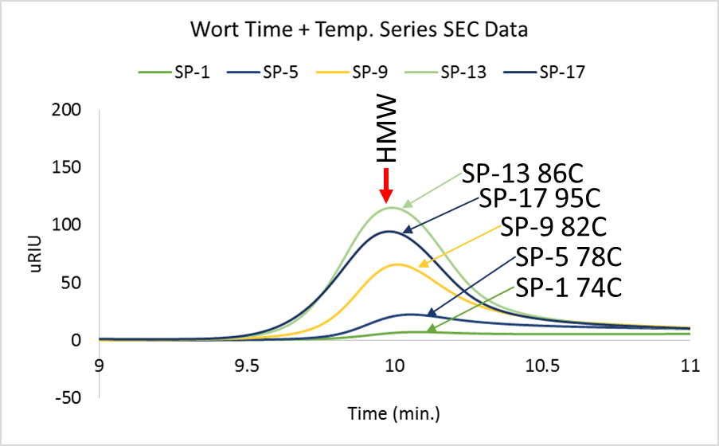
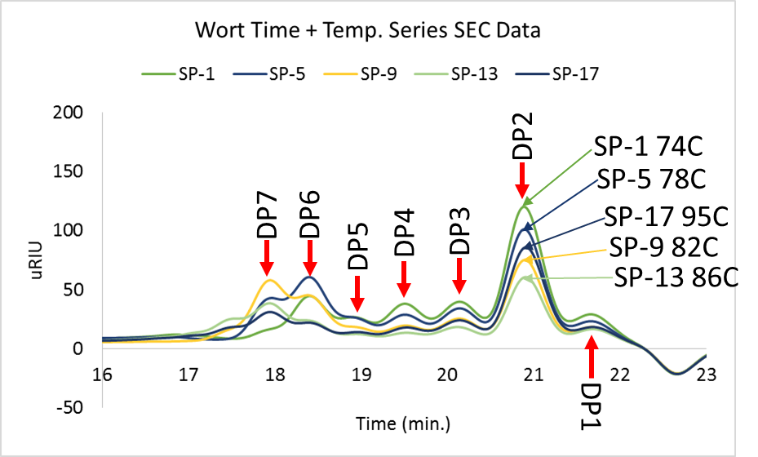
Project Status: Montreal / Mascoma analysis
Notes:
More in depth data shows how the degree of polymerisation is influenced by temperature. Of most interest is DP 4-7

Slide 11
Other wort production considerations
Malt bill
Wort strength
Hopping rates
Boil times and additions
Liquor salts

Slide 12
Creating a great tasting low or no alcohol beer requires a holistic approach to both wort and beer creation. All parts make up the whole and must be considered when designing low alcohol beers.
Great tasting low or no alcohol beer
Wort Production and design
Fermentation Method
Choice of Organism
Alcohol removal or dilution
pH correction
Stabilisation

Slide 13
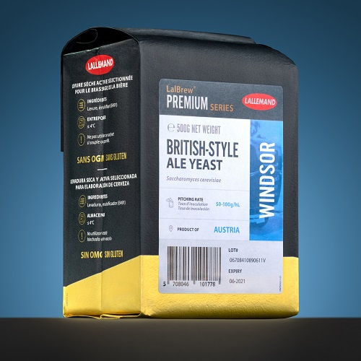
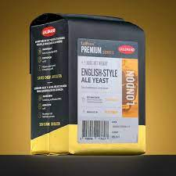

Choose you micro-organism(s). Understand and control the flow of carbon from sugar to metabolite
Ferments
Produces
Organism
Lactic acid
Alcohol
Ale
✔
✔
✔
X
✔
Lalbrew London / Windsor
✔
✔
X
X
✔
Maltose negative
✔
X
X
X
✔
Acid producing
✔
✔
✔
✔
✔
Lactic acid bacteria
✔
X
X
✔
X
Notes:
The final ethanol content of a beer can be influenced by the yeast and bacteria chosen for fermentation. Some yeast will only ferment simple sugars, naturally reducing the final ethanol content while others will ferment glucose to lactic acid instead of ethanol. Understanding the properties of the organism you choose can help influence the final ethanol content of the beer and control the pH.

Slide 14
Fermentation options
Standard fermentation with a maltose negative yeast
Kettle or FV souring with bacteria followed by fermentation with maltose negative yeast
Standard fermentation with maltotriose negative yeast and hot mashing
Kettle or FV souring with bacteria followed by fermentation with maltotriose negative yeast along with hot mashing
Cold contact fermentation (lager yeast)

Slide 15
Creating a great tasting low or no alcohol beer requires a holistic approach to both wort and beer creation. All parts make up the whole and must be considered when designing low alcohol beers.
Great tasting low or no alcohol beer
Wort Production and design
Fermentation Method
Choice of Organism
Alcohol removal or dilution
pH correction
Stabilisation

Slide 16
Alcohol removal or dilution
Sometimes even using hot mashing and yeasts of limited fermentability a dilution step is required to meet the desired alcohol step. Ideally this should be made with sterile deaerated water.
For very low alcohol content an alcohol removal step may be required. There are many technologies out there but reverse osmosis (RO) seems to be the technique being favoured

Slide 17
Creating a great tasting low or no alcohol beer requires a holistic approach to both wort and beer creation. All parts make up the whole and must be considered when designing low alcohol beers.
Great tasting low or no alcohol beer
Wort Production and design
Fermentation Method
Choice of Organism
Alcohol removal or dilution
pH correction
Stabilisation

Slide 18
The Importance of pH correction
Problems:
Low gravity worts can lead to high pH due to their limited buffering capacity
Limited fermentation compounds the issue as yeast produce organic acids during fermentation
This can lead to:
Astringent tannic worts
A high degree of perceived bitterness
Poor microbiological stability including the potential for growth of pathogens

Slide 19
The Importance of pH correction
Solutions:
Correct pH at all stages, mash, boil, post boil and post fermentation using food grade acid additions
Hop at an appropriate level
Adjust the pH of sparge water to the desired wort pH (5-5.2) by acid addition to the HLT
An additional point here is that it is possible to use many different acids at this point and each will impart a different flavour

Slide 20
Creating a great tasting low or no alcohol beer requires a holistic approach to both wort and beer creation. All parts make up the whole and must be considered when designing low alcohol beers.
Great tasting low or no alcohol beer
Wort Production and design
Fermentation Method
Choice of Organism
Alcohol removal or dilution
pH correction
Stabilisation

Slide 21
Stabilisation
Stabilisation is the most commonly overlooked factor in the production of low alcohol beers by craft brewers. If we think about regular beer it is relatively microbiologically stable and pathogens struggle to grow or survive for the following reasons.
It is nutritionally poor / depleted
It has a high alcohol content
It has a low pH
It contains hop acids
All of these are altered or reduced to a degree in low alcohol beer

Slide 22
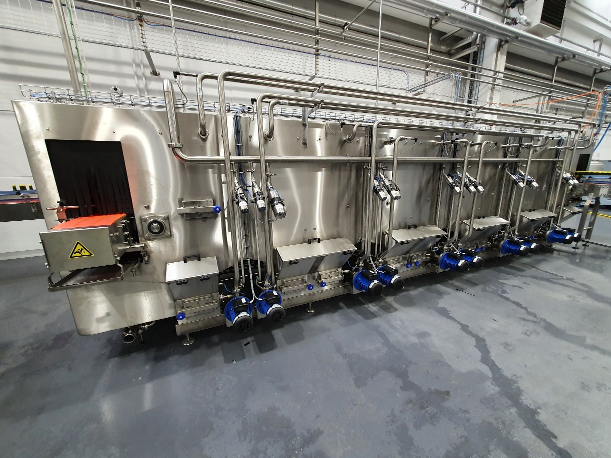
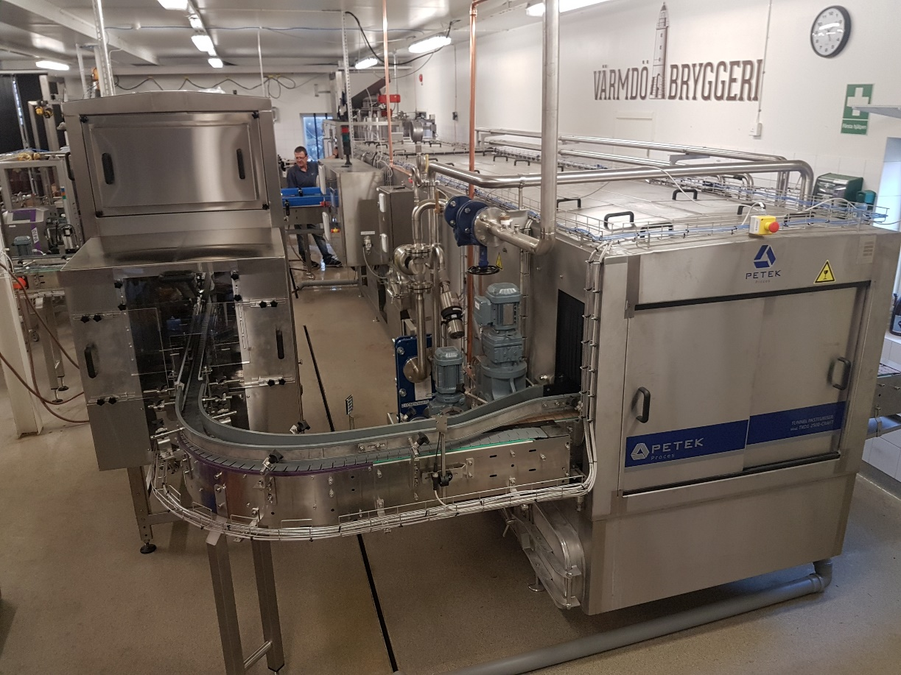
How to stabilise
It can be a dirty word among craft brewers but the gold standard way of stabilising beer is to pasteurise after packaging using a tunnel pasteuriser.
Flash pasteurisation has a lower footprint and is easier to implement but there is risk to the product from contamination during the brewing process
Chemical stabilisation using Potassium Sorbate or Sulphur Dioxide

Slide 23
Conclusions
Making low alcohol beer isn’t as simple as adding a different yeast to one of your regular beers. It requires a holistic approach taking into account all parts of the whole and some serious R&D effort to get it right.
As a first step I would recommend the following:
High temperature mashing
Fermentation with maltotriose negative yeasts (London or Windsor)
pH correction
Stabilisation

Slide 24
Questions

