Slide 1
Recent developments and concerns in malting
Csaba Papp | The Swaen

Slide 2
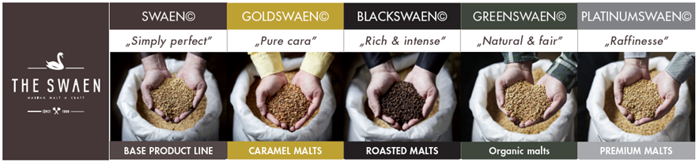
Overview
How malt is made, technical developments
Ways of differentiation
Sustainability in sourcing and production
COVID impacts on the industry
What’s up in the fields?

Slide 3
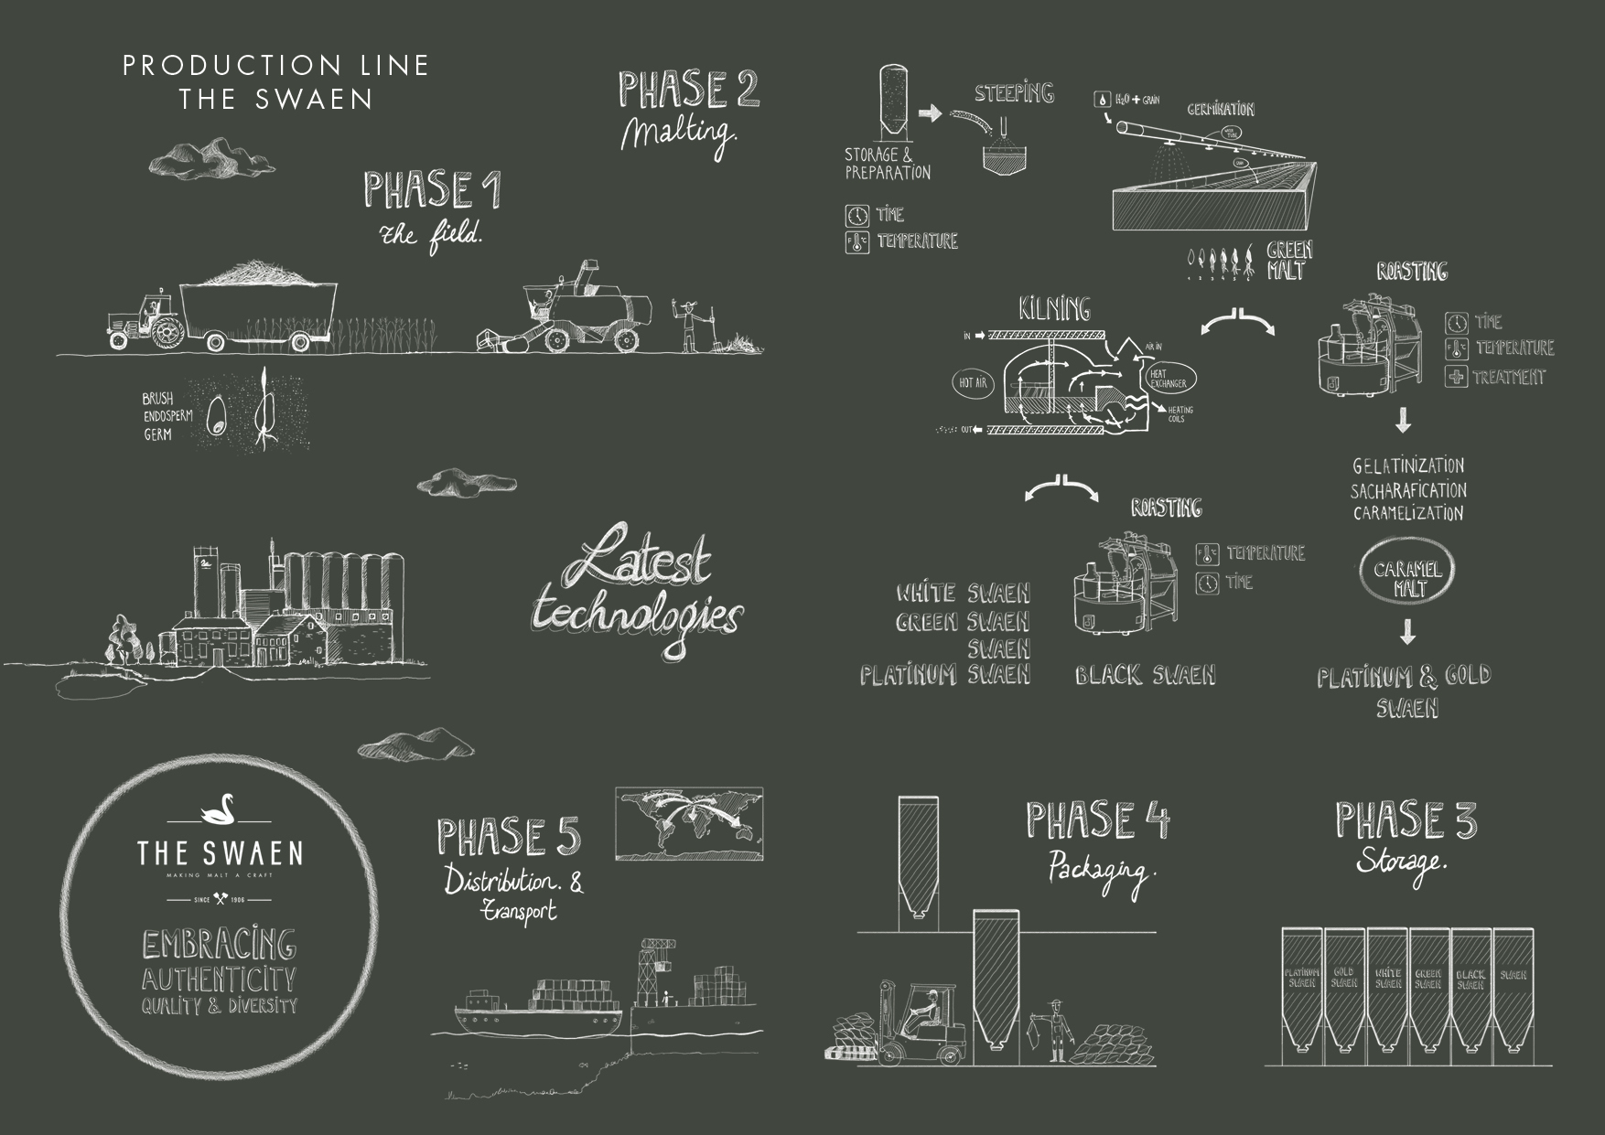
Our Production line

Slide 4
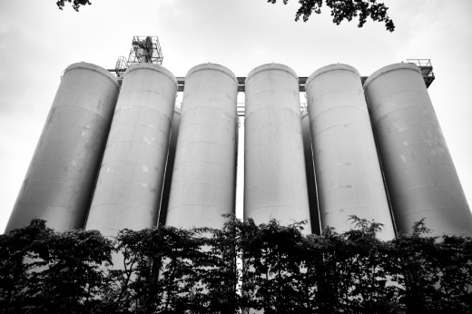
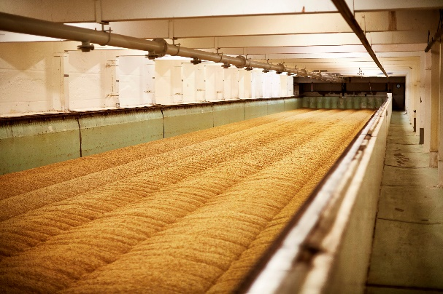
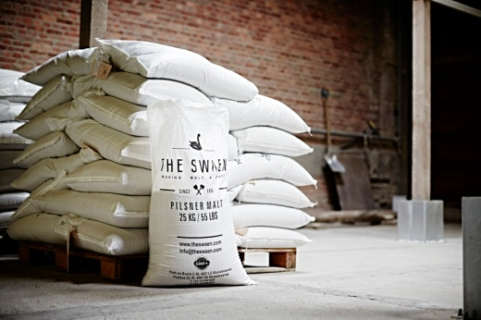
Malting process

Slide 5
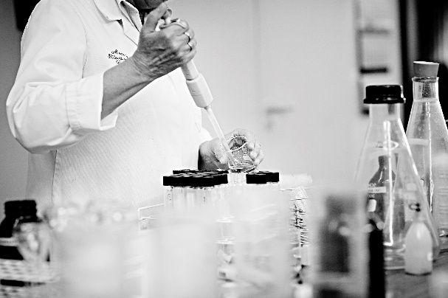
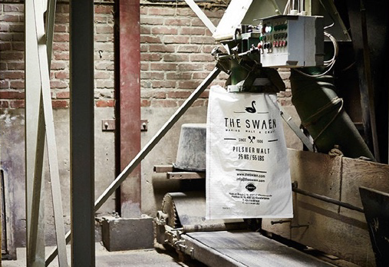
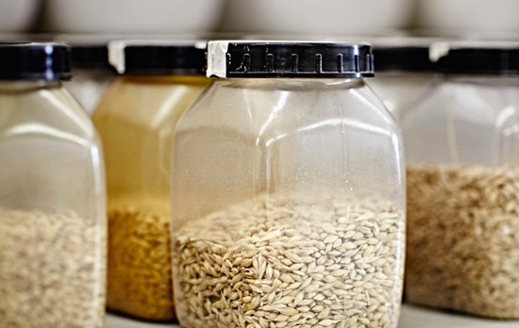
Technical developments
Mechanical malting
Roaster -> product innovation
Bagging lines
Automazited palletizing
Advanced laboratory
IT solutions

Slide 6
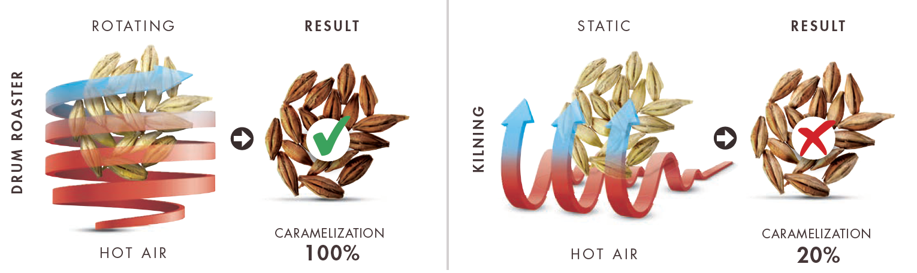
Production of crystal vs caramel malt
Perfect temperature control
Even temperature distribution
Optimal moisture control and distribution
Even saccharification
Even and real caramelization
Even caramel colour and flavour
Homogenous malt
Con: kernels may damage
Kernels placed layered and unevenly
Hot spots and colder areas
Moisture saturation -> evaporation loss
Lower temperature
No saccharification & caramelization
• No pronounced caramel color and flavor
• Low homogenity

Slide 7


What’s new in marketing
Social media push
Quality vs quantity: finding the right balance
Track user engagement
New product launch – capabilities vs ideas
Webinars

Slide 8
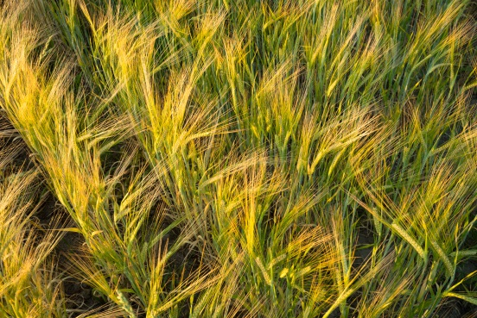
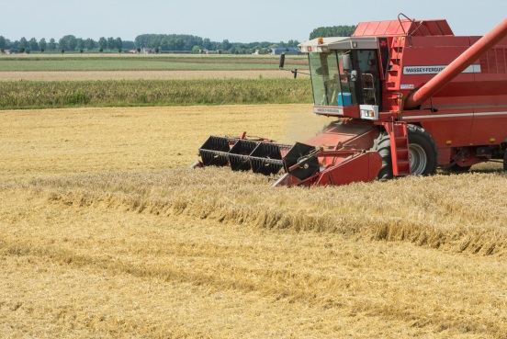
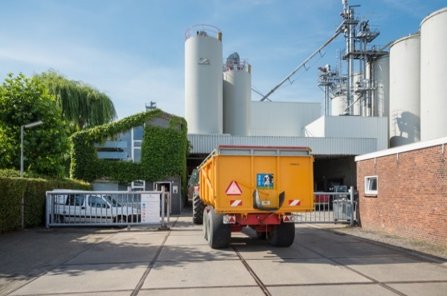
Sustainable sourcing
Changing mindset in beer consumption
Requirement from large breweries
Standards in the fields
Growing „The Swaen” farming programme
Tracking and tracing
Difficulties in storage

Slide 9
Sustainability in production
Reduced water and energy usage
Goal to become CO2 neutral
Comprehensive energy audit
Usage of renewable energy
Optimize inbound transport
Move to web-based communication

Slide 10
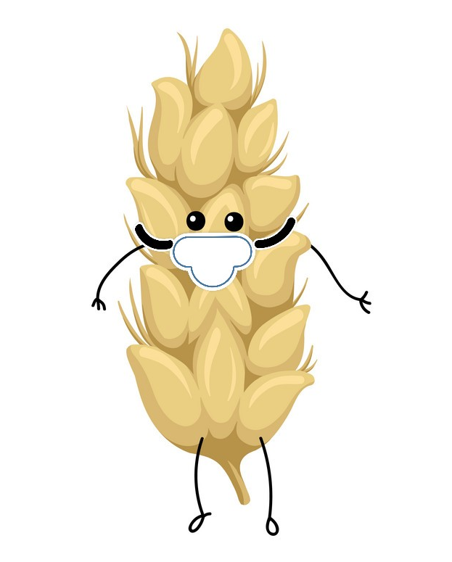
Production during COVID
Stop production = waste of money
Building up large stocks vs limited space
Seasonality
Different lockdown regulations
Time for projects

Slide 11
Crop 2021 summary
Substantial weather damage
  cold spring -> late planting
  heatwaves and rain deficit in summer
  rains in many regions
  before and during harvest
  poor quality
  low grading numbers
  reduced yield

Slide 12
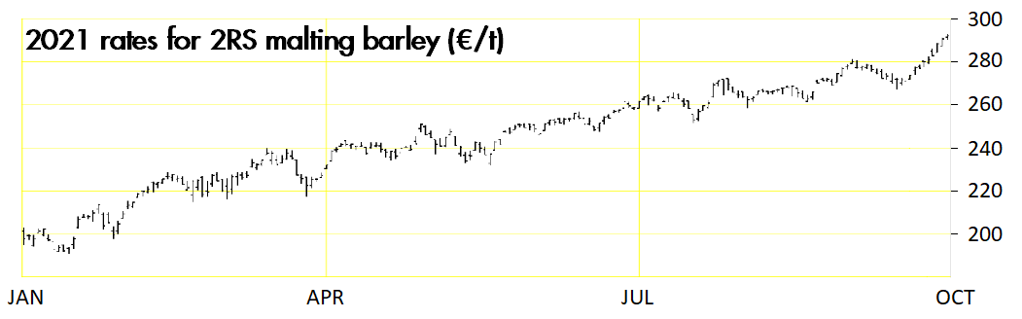
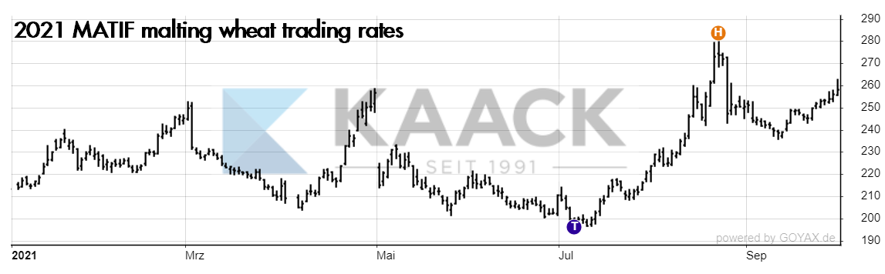
Barley rates in 2021
Winter barley: less affected by hot, slight reduction in yield
Organic barley: -40% yield, decreasing number of farmers

Slide 13

Expectations to 2022
Brewing barley < demand of beer industry
Shortage worldwide
Market to grow narrow
No carry-over malt stocks
Try to make an LTA asap
Crop 2022 - lower future rates (until when?)

Slide 14
Thank you!
Questions?

